Slide 1
Image Processing
Two dimensional System

Slide 2
Fourier Transform
The Fourier transform decomposes a function of time (a signal) into the frequencies that make it up, similarly to how a musical chord can be expressed as the amplitude (or loudness) of its constituent notes.
It states that any signal can be represented by the integral of sine and cosine multiplied by weighing function.
In image processing, it is very important to decompose an image in its sine and cosine components.
Notes:
2

Slide 3
Fourier Transform
Output of the transformation represents the image in Fourier or frequency domain.
In Fourier domain image, each point represents a particular frequency contained in the spatial image.
The Fourier transform is called the frequency domain representation of the original signal. The term Fourier transform refers to both the frequency domain representation and the mathematical operation that associates the frequency domain representation to a function of time
Notes:
3

Slide 4
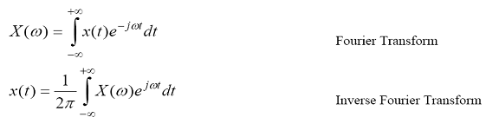
Fourier Transform
Fourier transform of x(t) may be written as convenience as
Where w is continuous variable.
Notes:
4

Slide 5
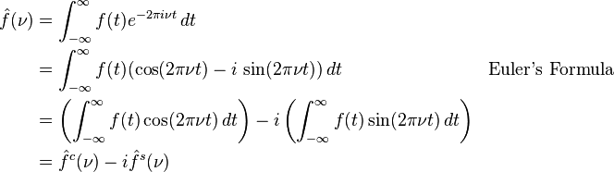
Fourier Transform
Using Euler's formula
e^{ix} = cosx + i.sinx
We can express Fourier transform as:
Notes:
5

Slide 6
Fourier Transform
An important image processing tool which is used to decompose an image into its sine and cosine components.
Transform image into frequency domain.
Huge applications in image analysis, image filtering, image reconstruction and image compression etc.
Notes:
6

Slide 7
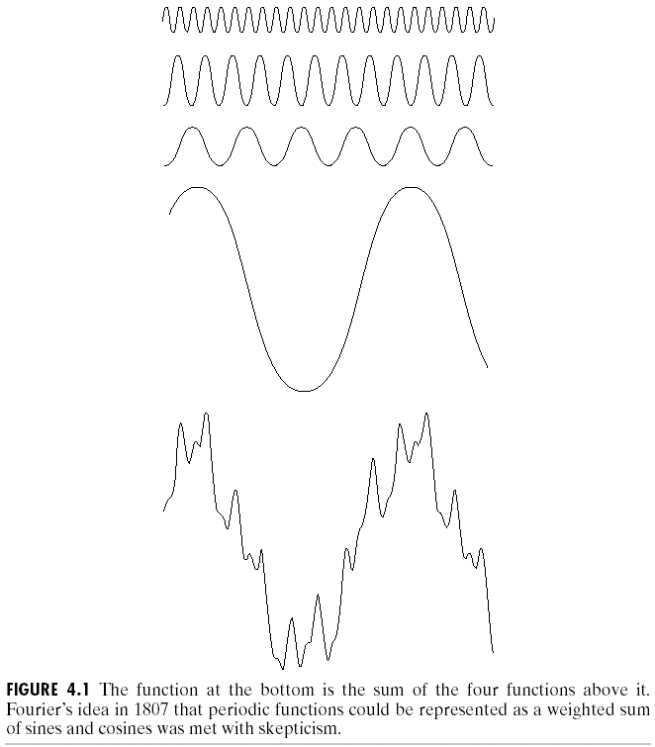

The Big Idea
=
Images taken from Gonzalez & Woods, Digital Image Processing (2002)
Any function that periodically repeats itself can be expressed as a sum of sines and cosines of different frequencies each multiplied by a different coefficient – a Fourier series
Notes:
7

Slide 8
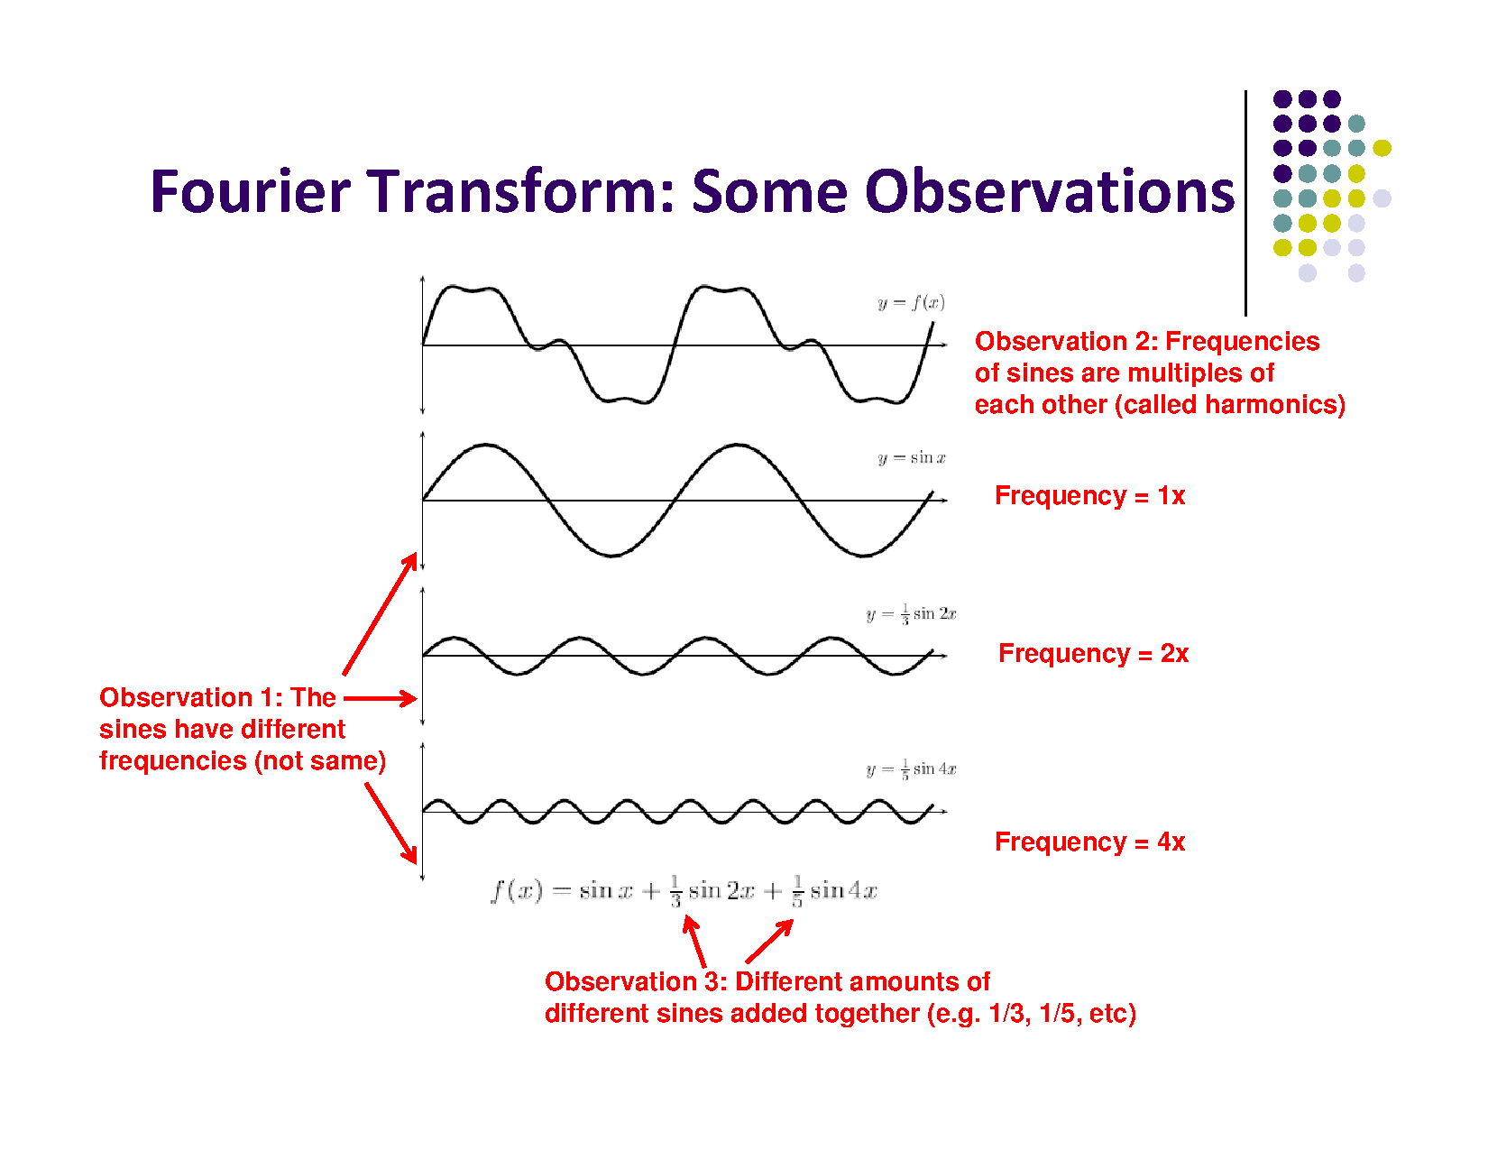

Slide 9
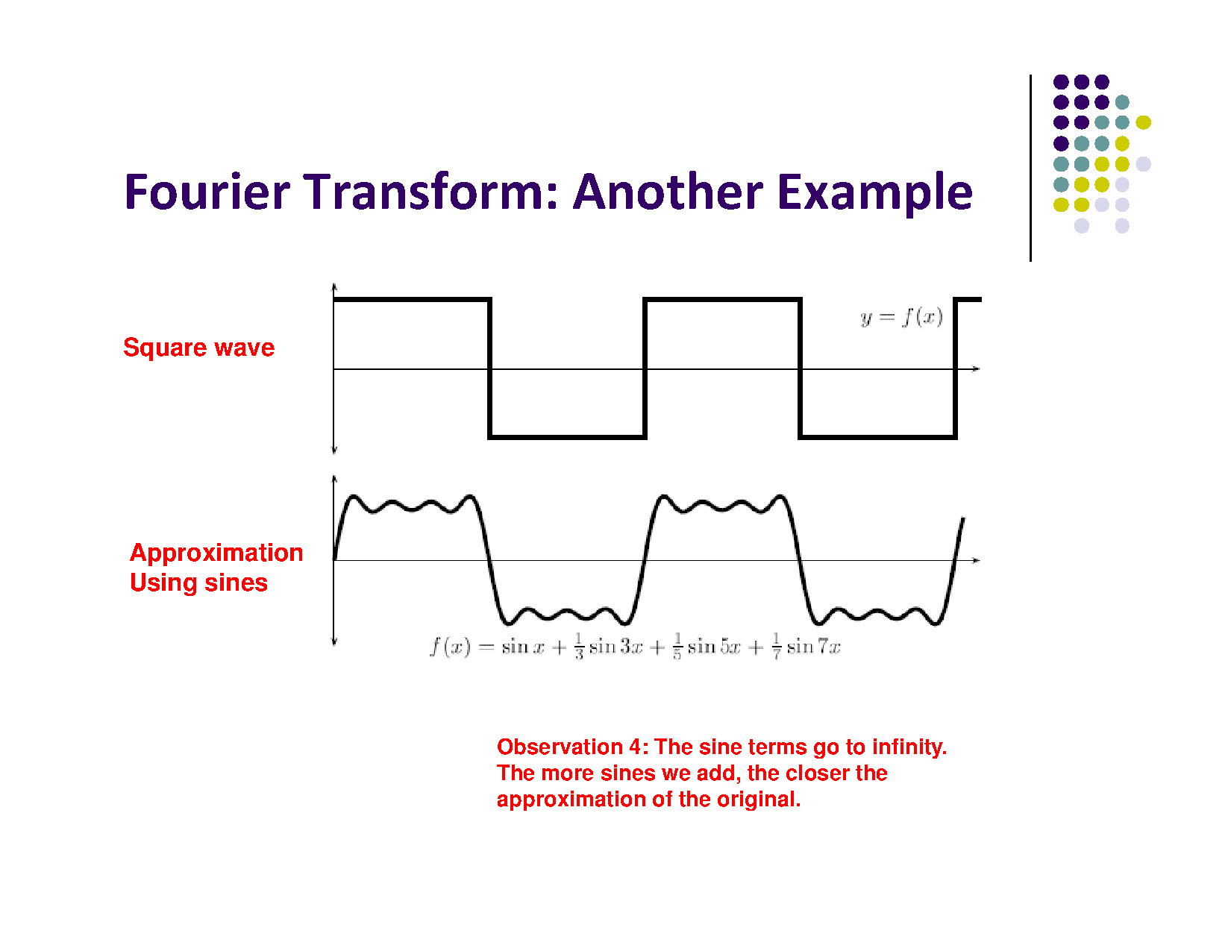

Slide 10
Discrete Fourier Transform
We are only concerned about images, we apply Discrete Fourier Transform(DFT).
DFT is the sampled Fourier Transform.
Does not contain all frequencies forming an image, but only set of samples which is large enough to fully describe the spatial domain image.
Number of frequencies corresponds to the number of pixels in spatial domain image, i.e. the image in the spatial and Fourier domain are of the same size.
Notes:
10

Slide 11
Discrete Fourier Transform
We are only concerned about images, we apply Discrete Fourier Transform(DFT).
DFT is the sampled Fourier Transform.
Does not contain all frequencies forming an image, but only set of samples which is large enough to fully describe the spatial domain image.
Number of frequencies corresponds to the number of pixels in spatial domain image, i.e. the image in the spatial and Fourier domain are of the same size.
Notes:
11

Slide 12
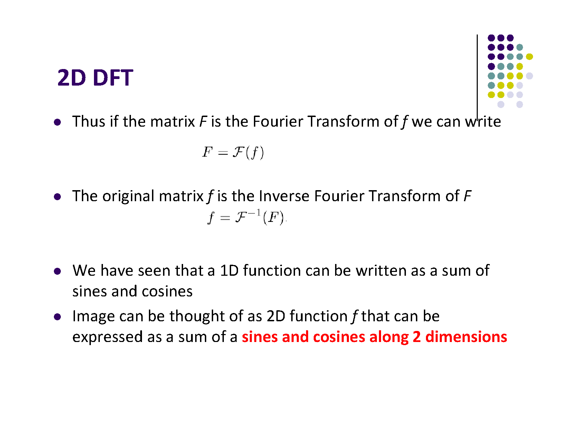

Slide 13
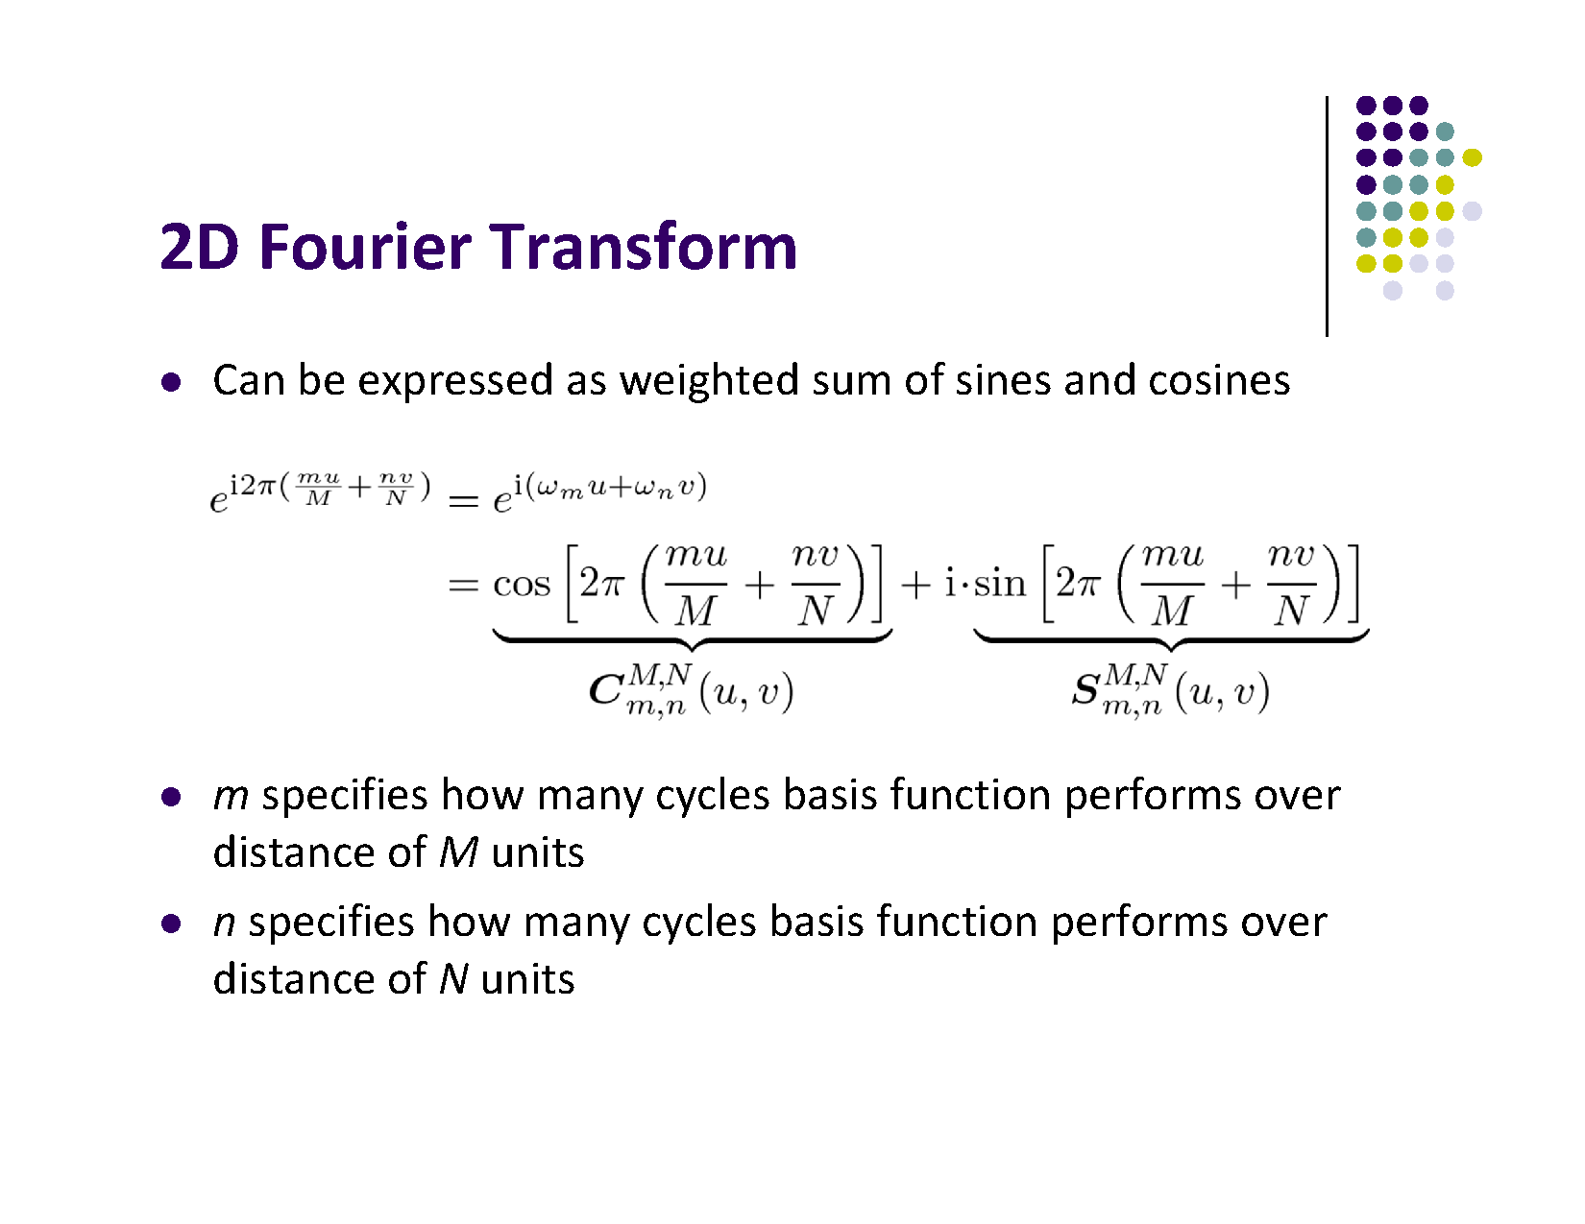

Slide 14
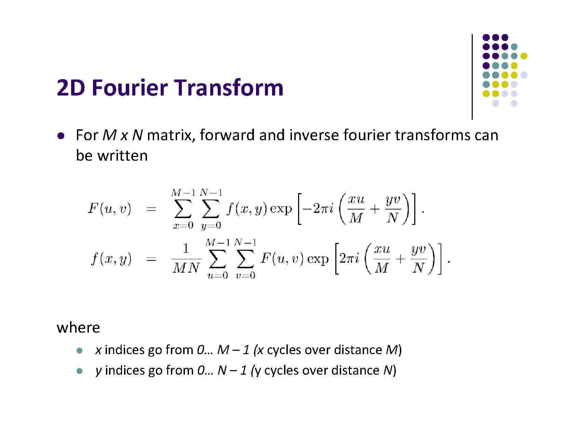

Slide 15
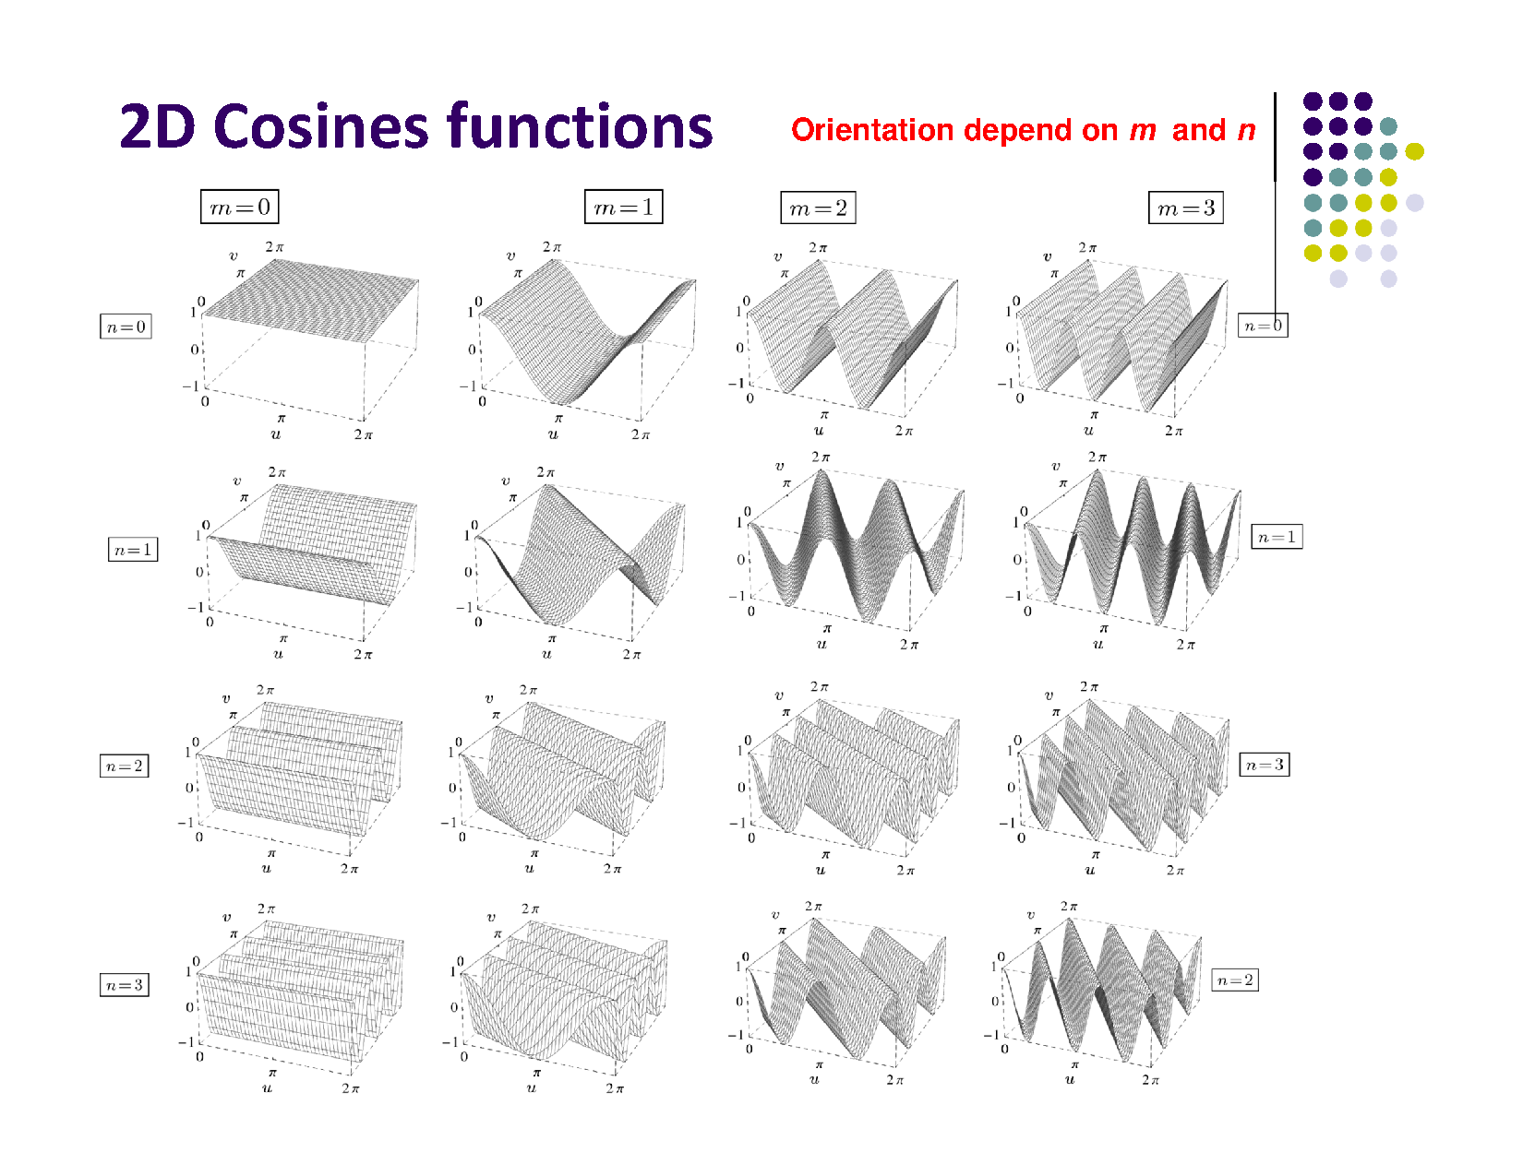

Slide 16
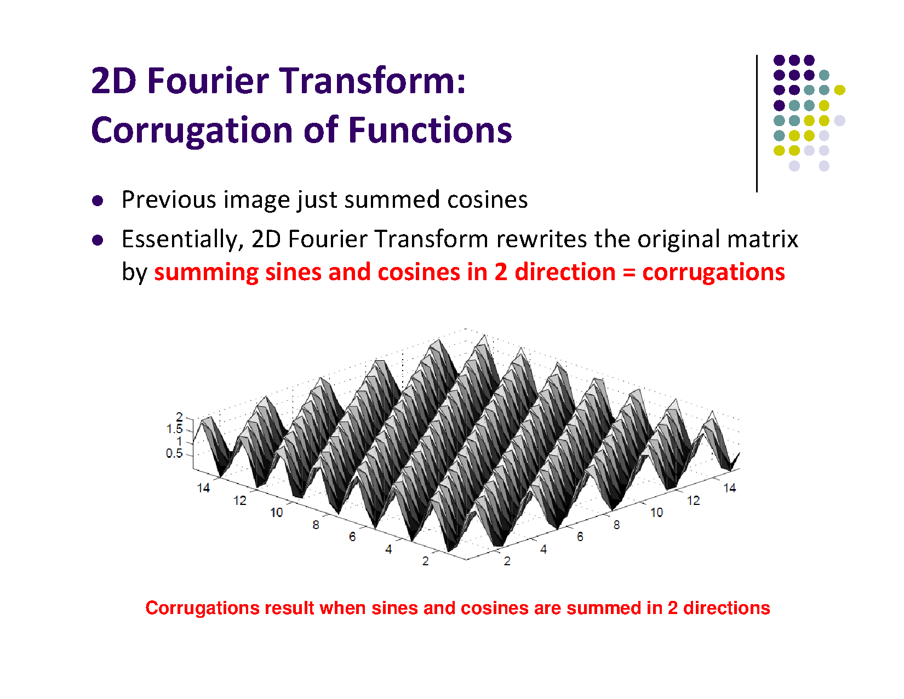

Slide 17
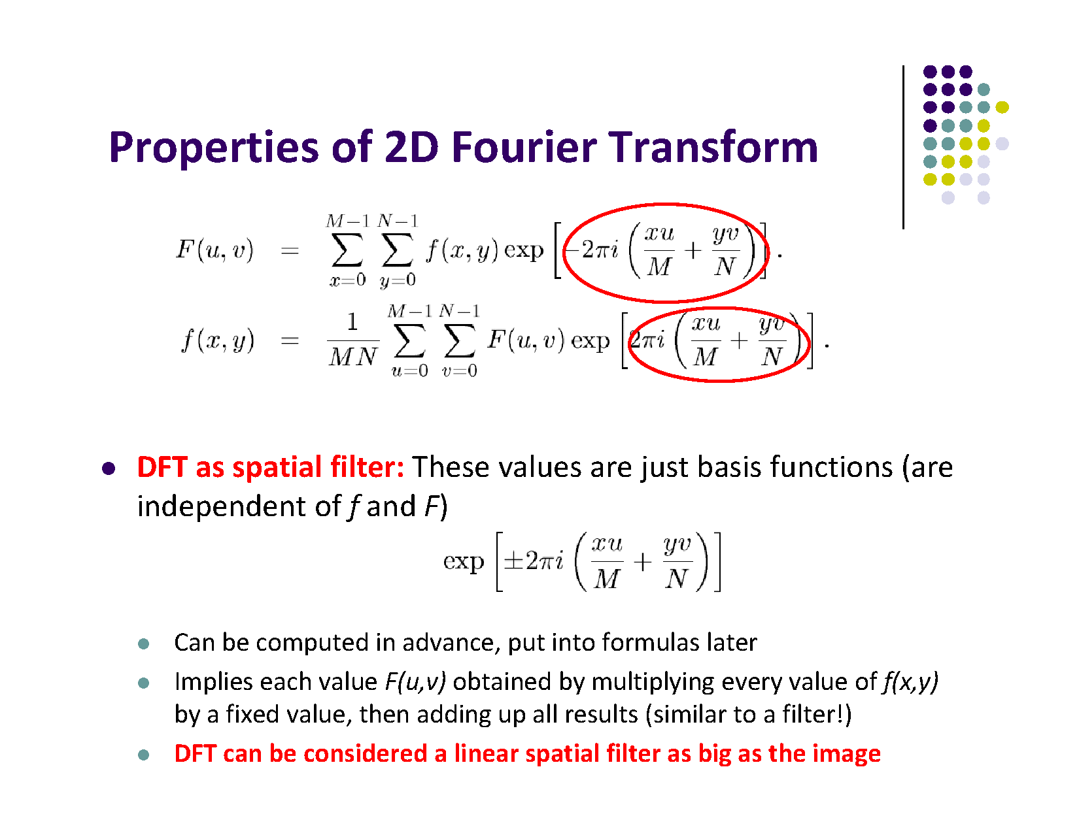

Slide 18
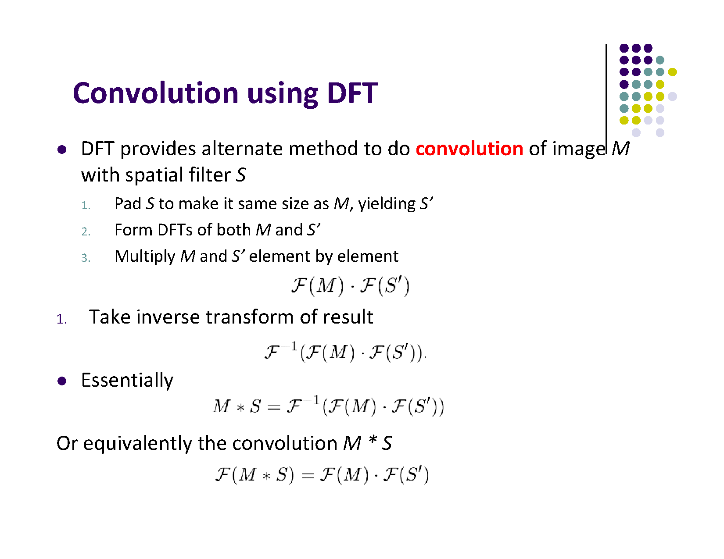

Slide 19
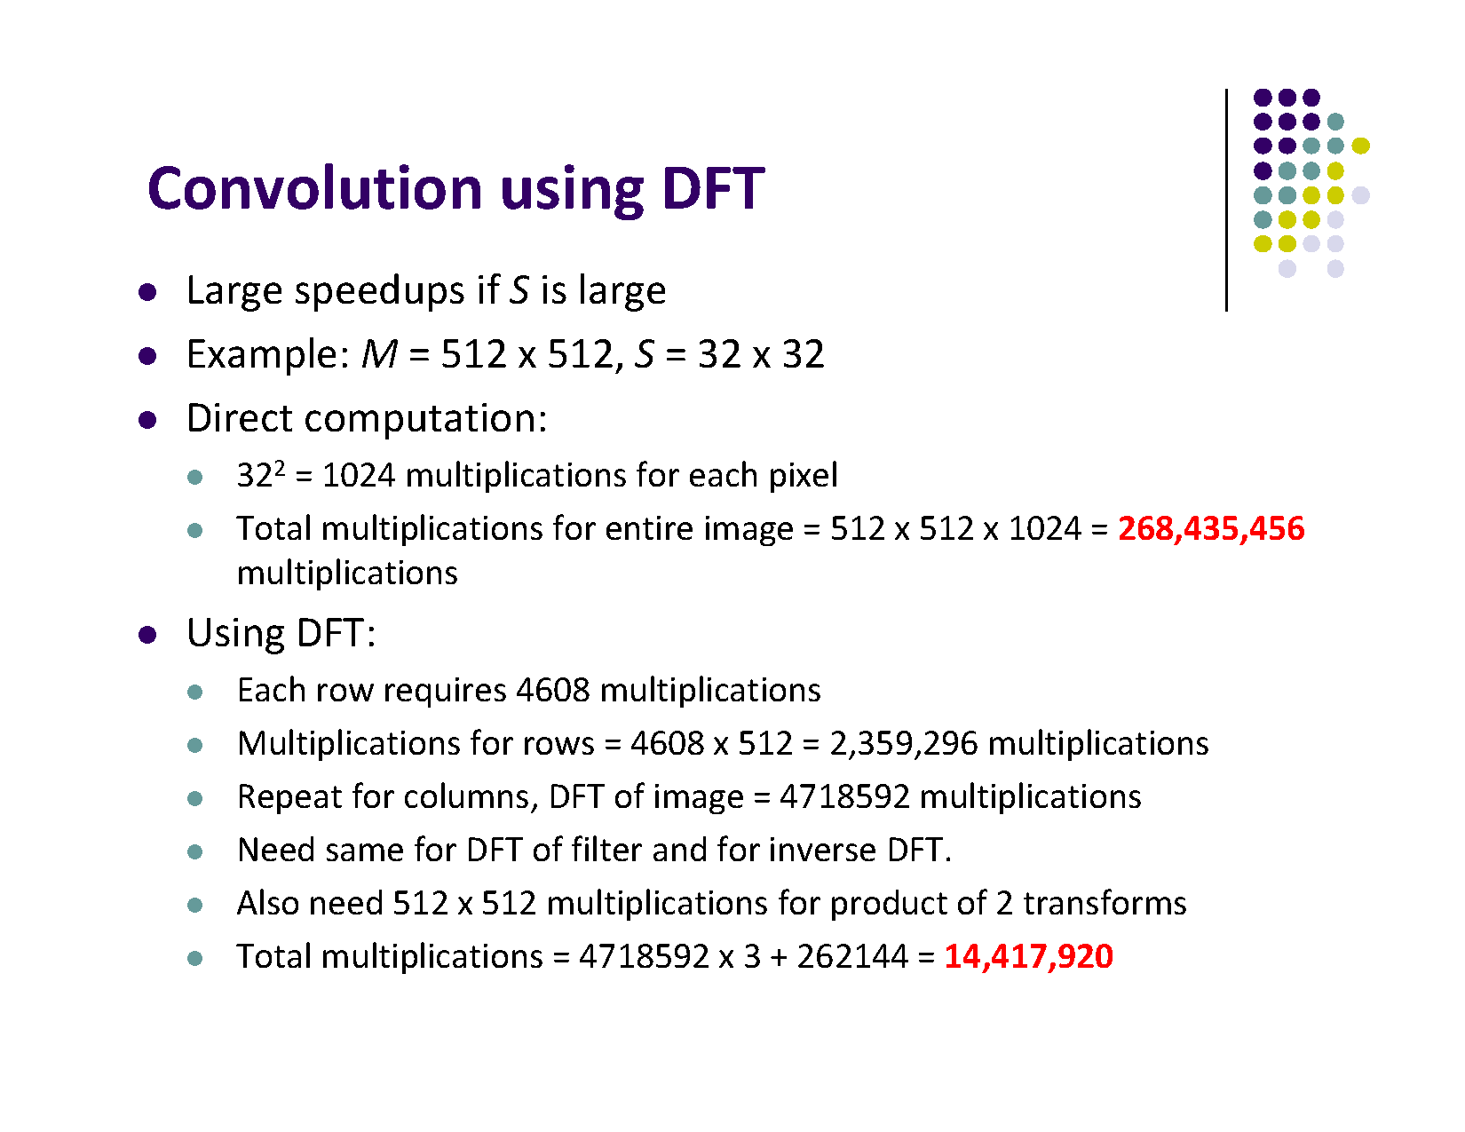

Slide 20
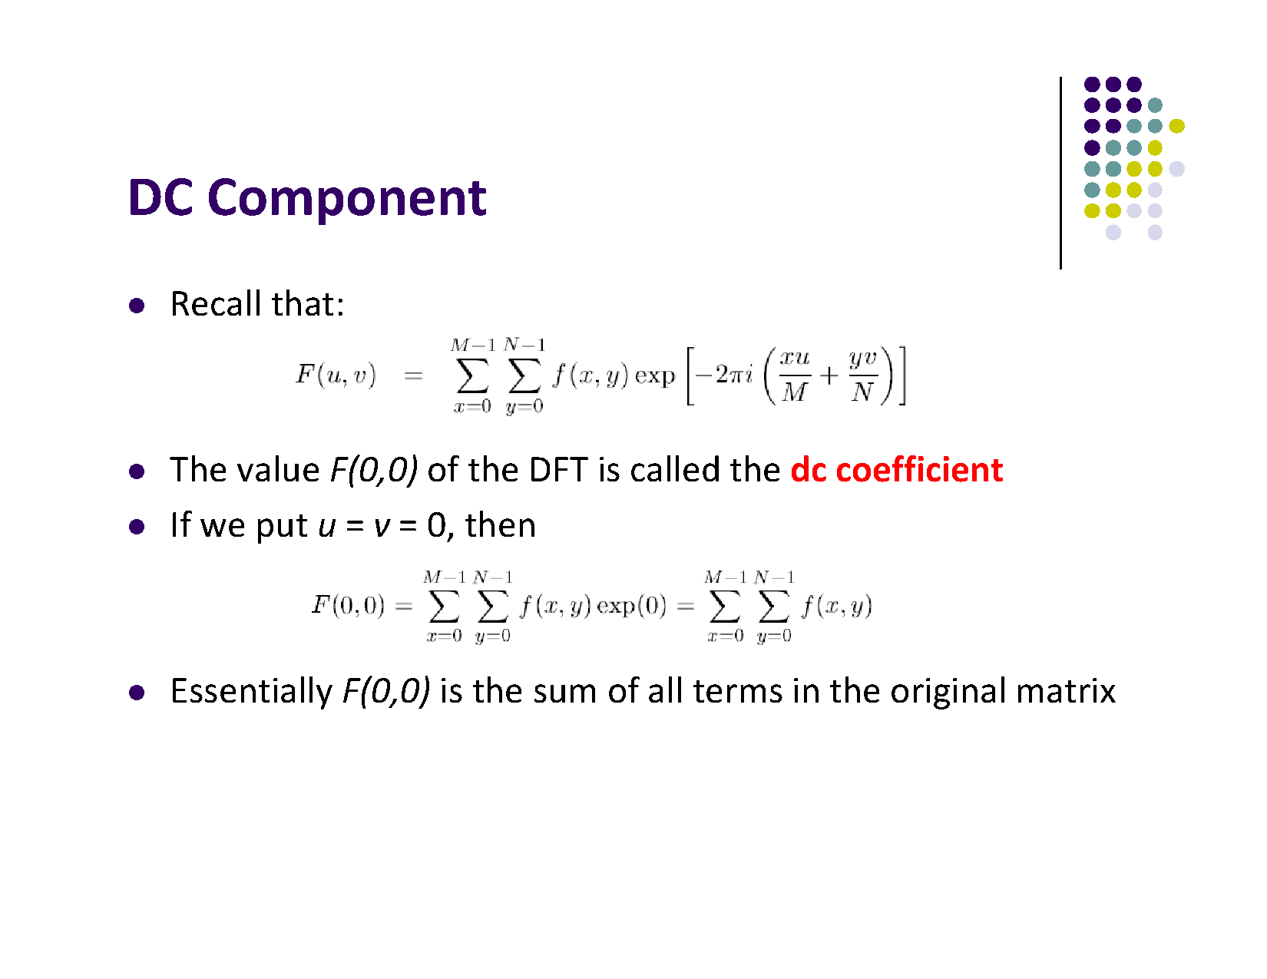

Slide 21
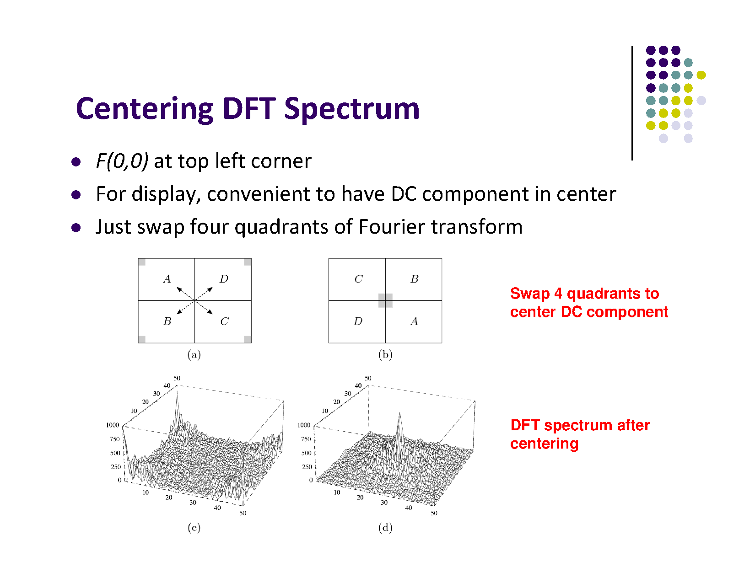

Slide 22
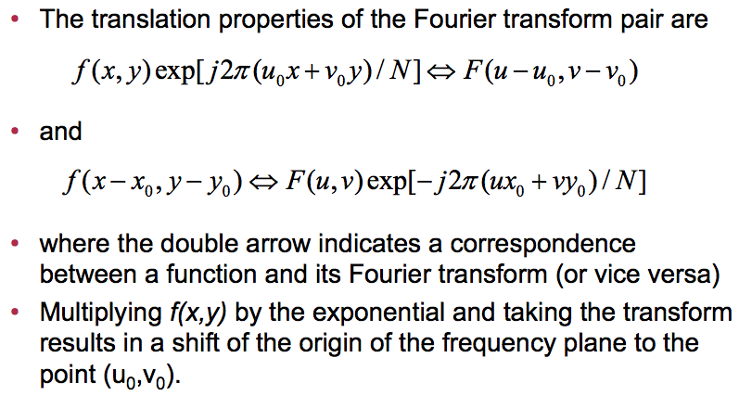
Translation
Notes:
22

Slide 23
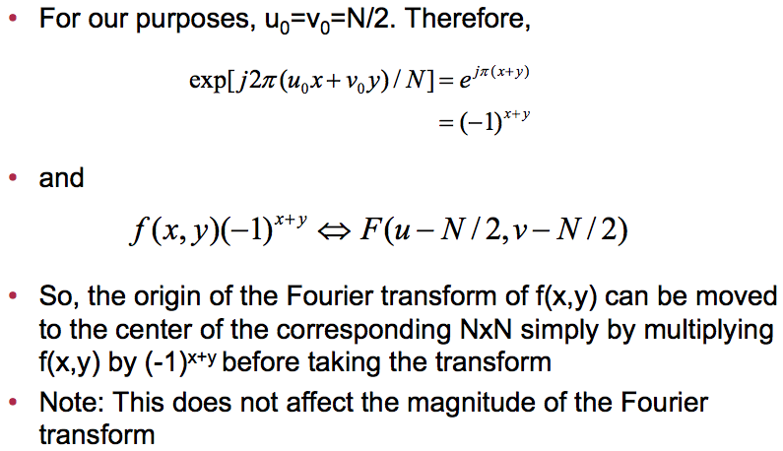
Translation (continued)
Notes:
23

Slide 24
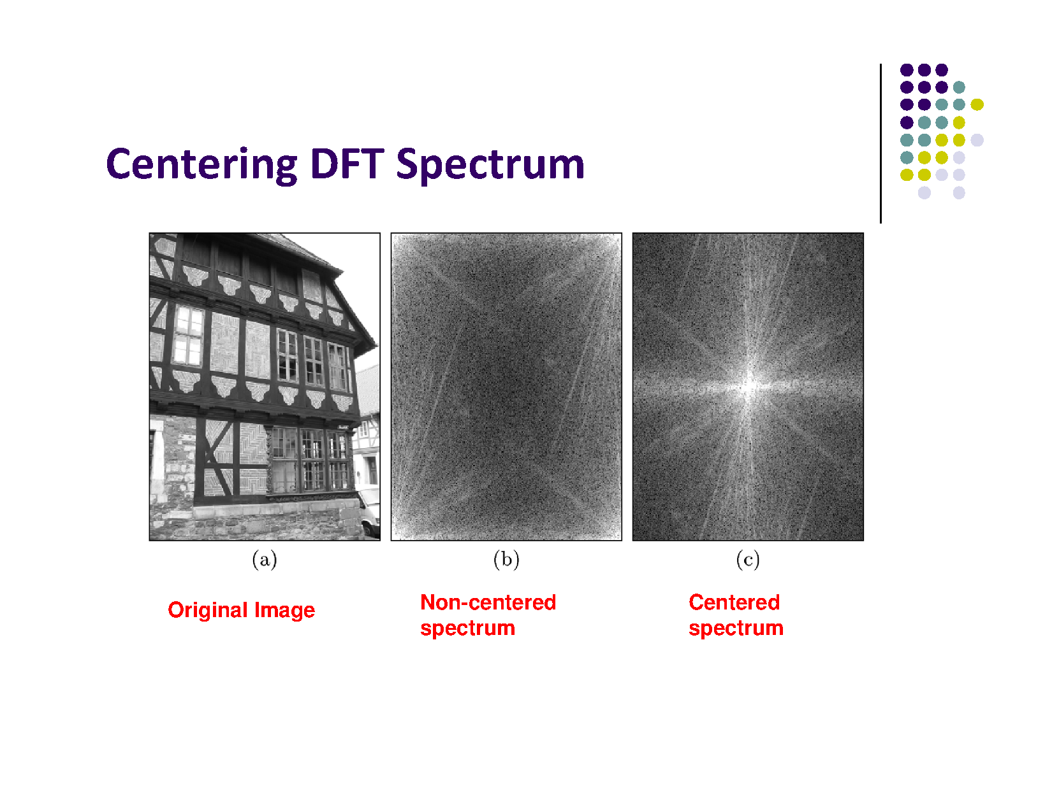

Slide 25
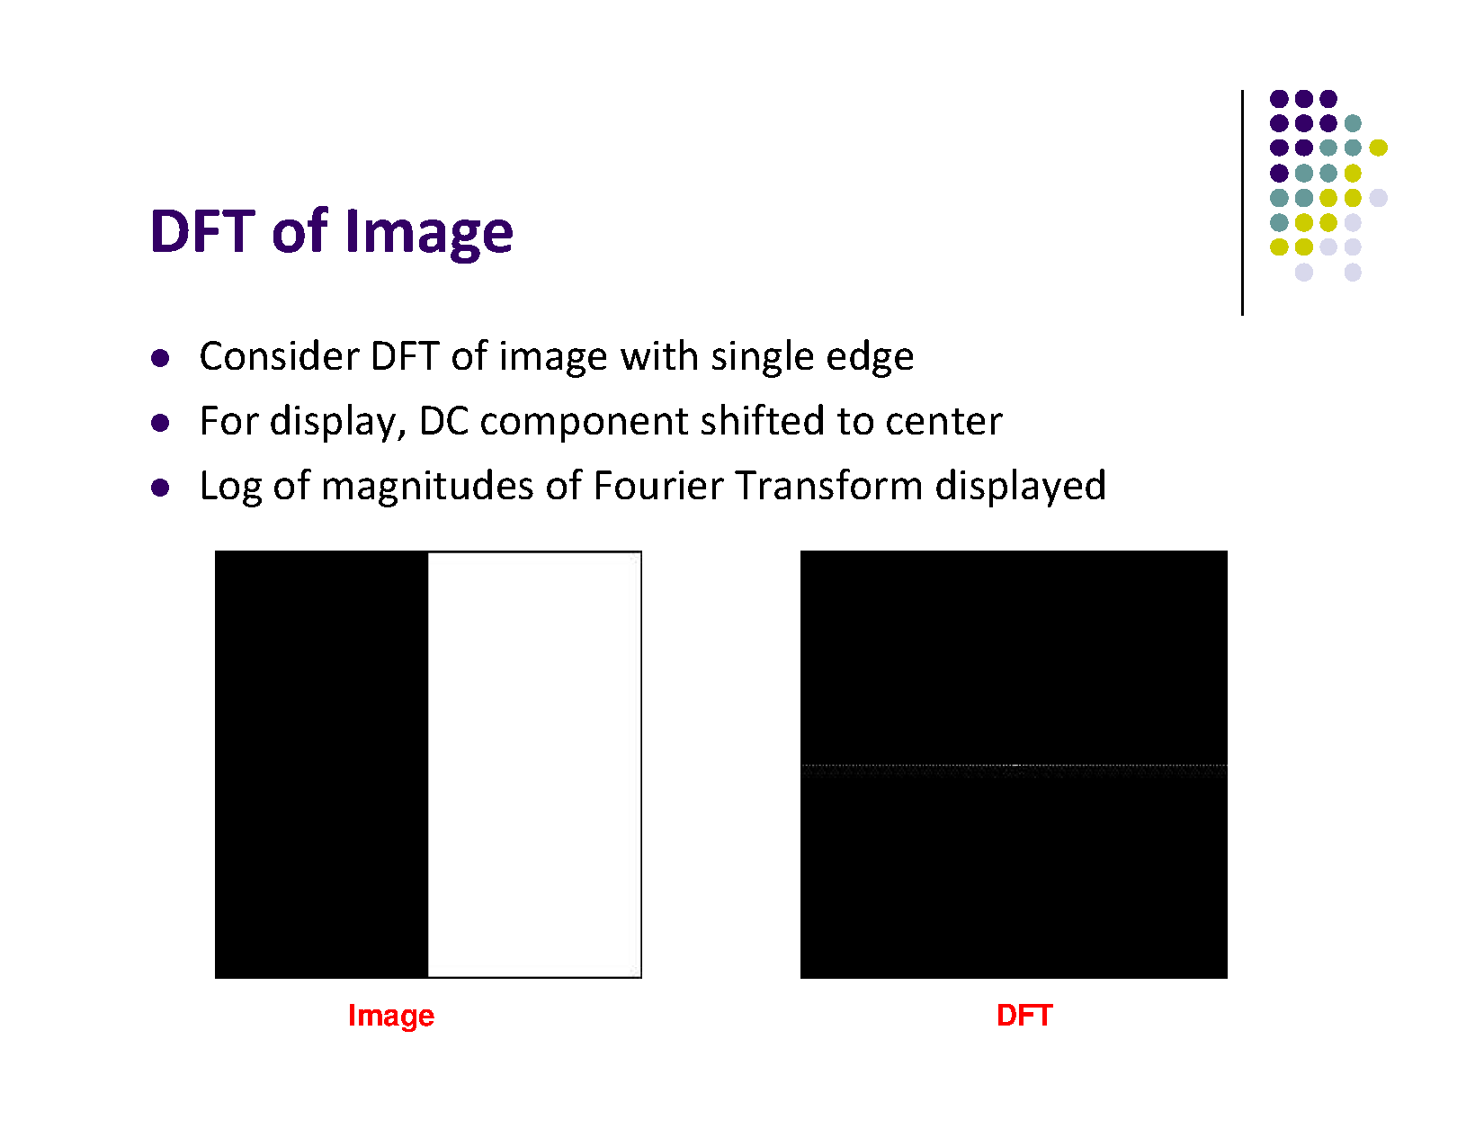

Slide 26
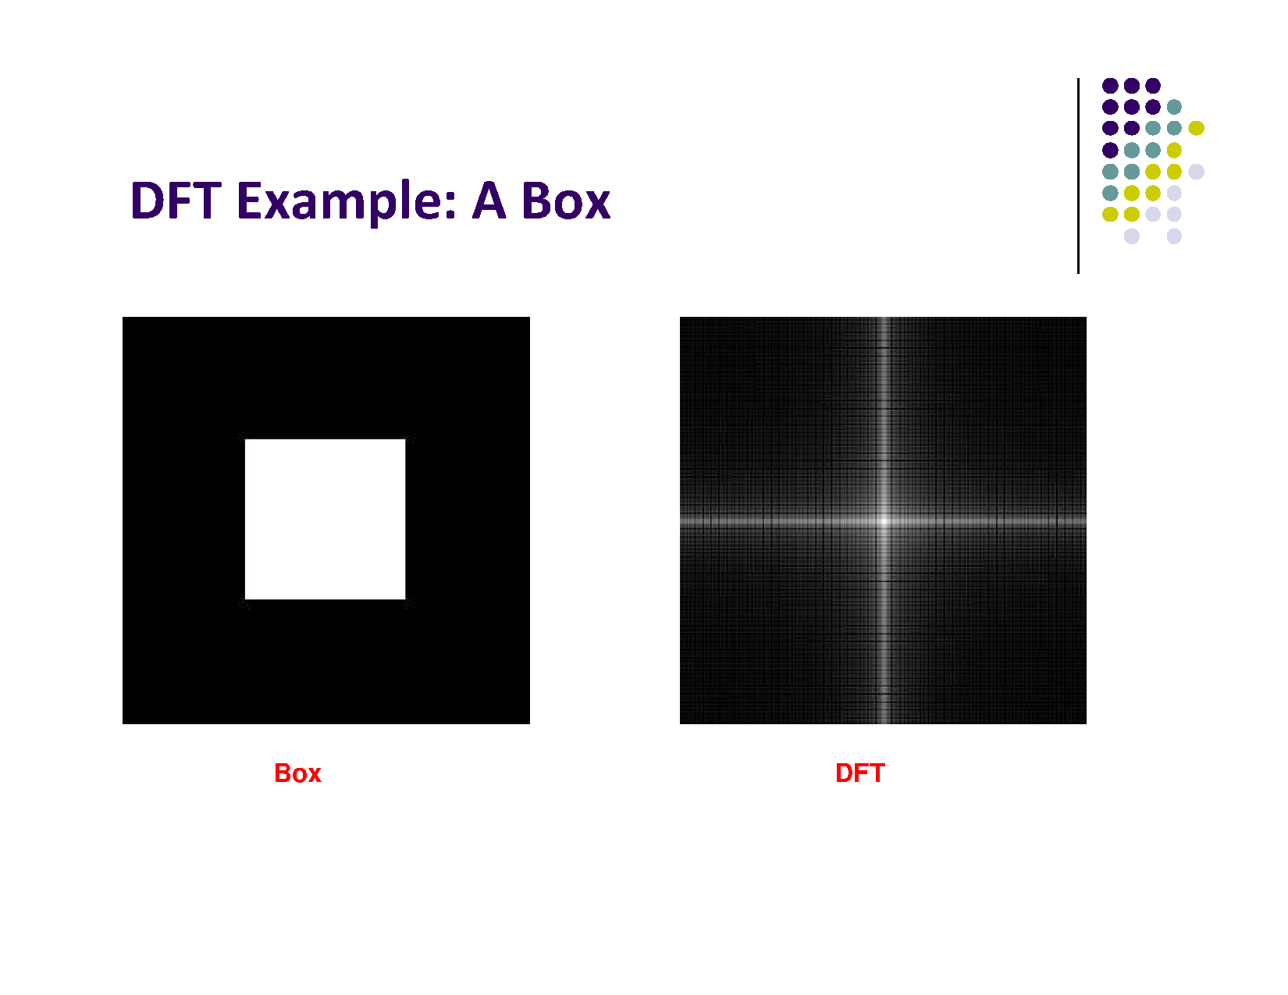

Slide 27
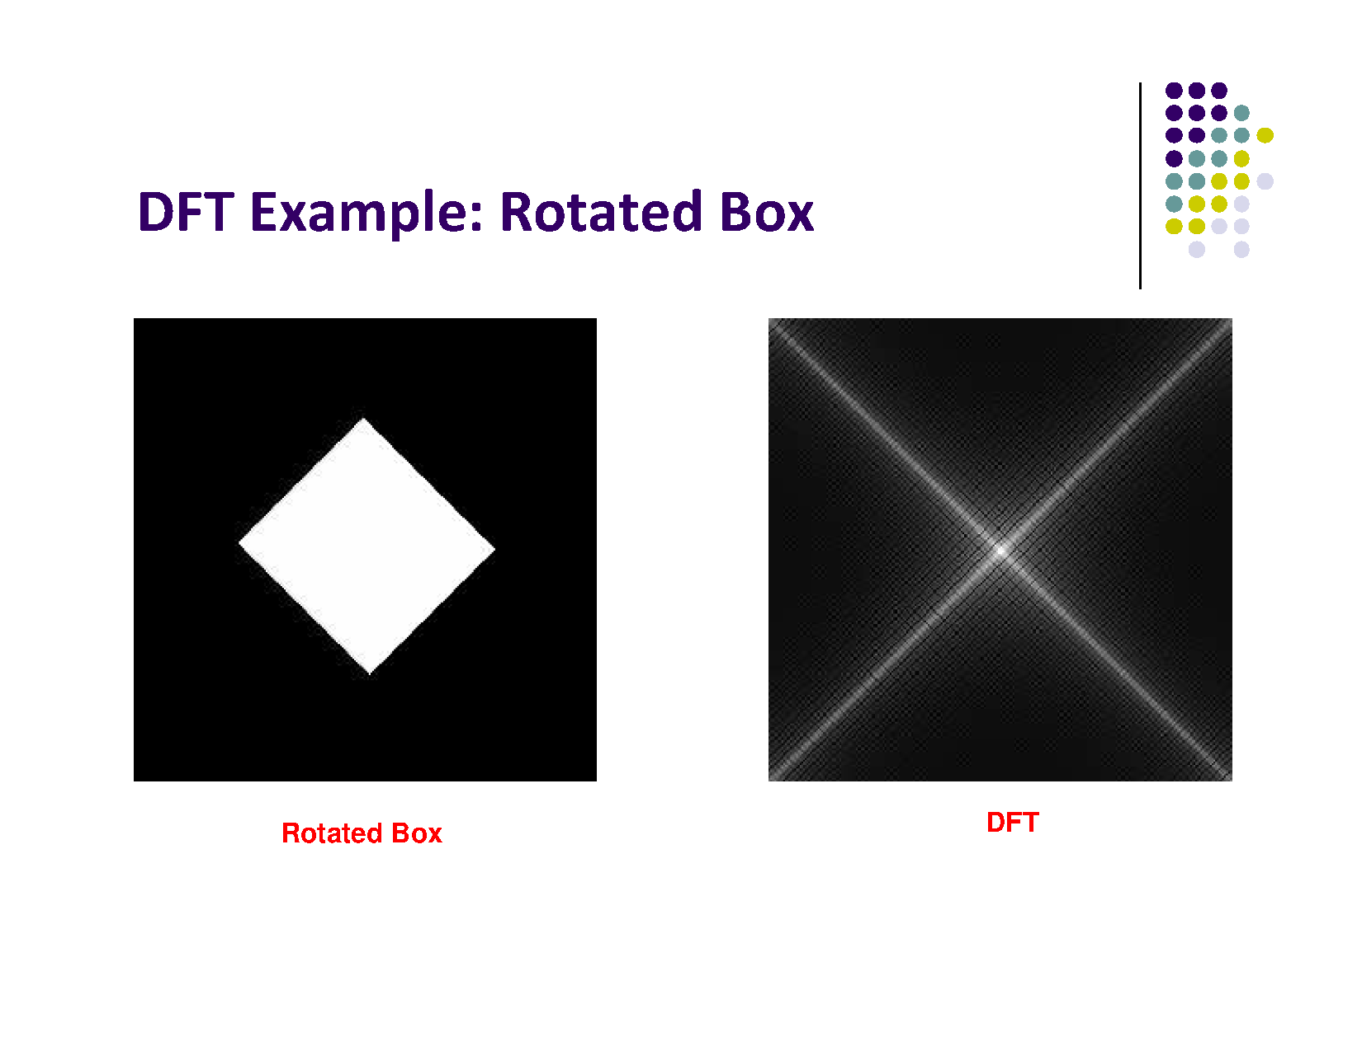

Slide 28
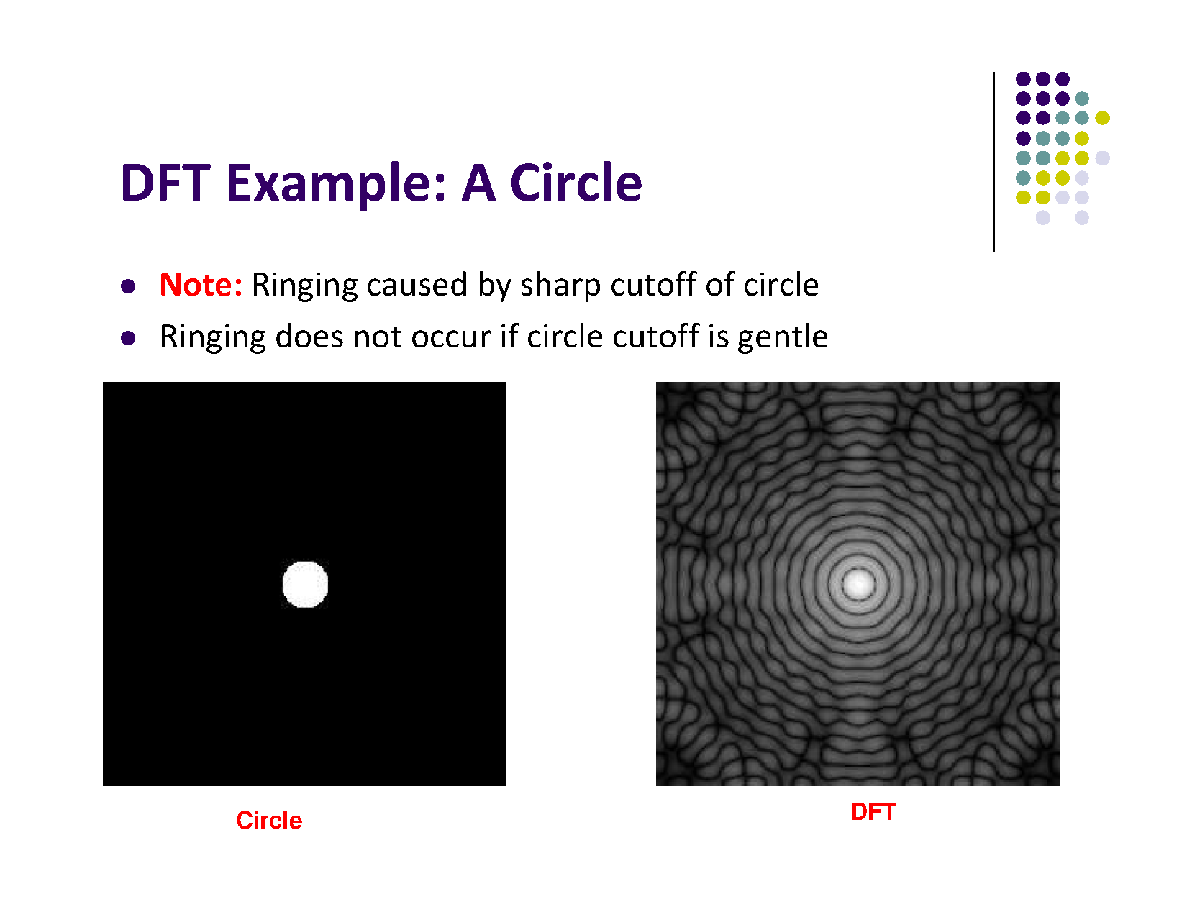

Slide 29
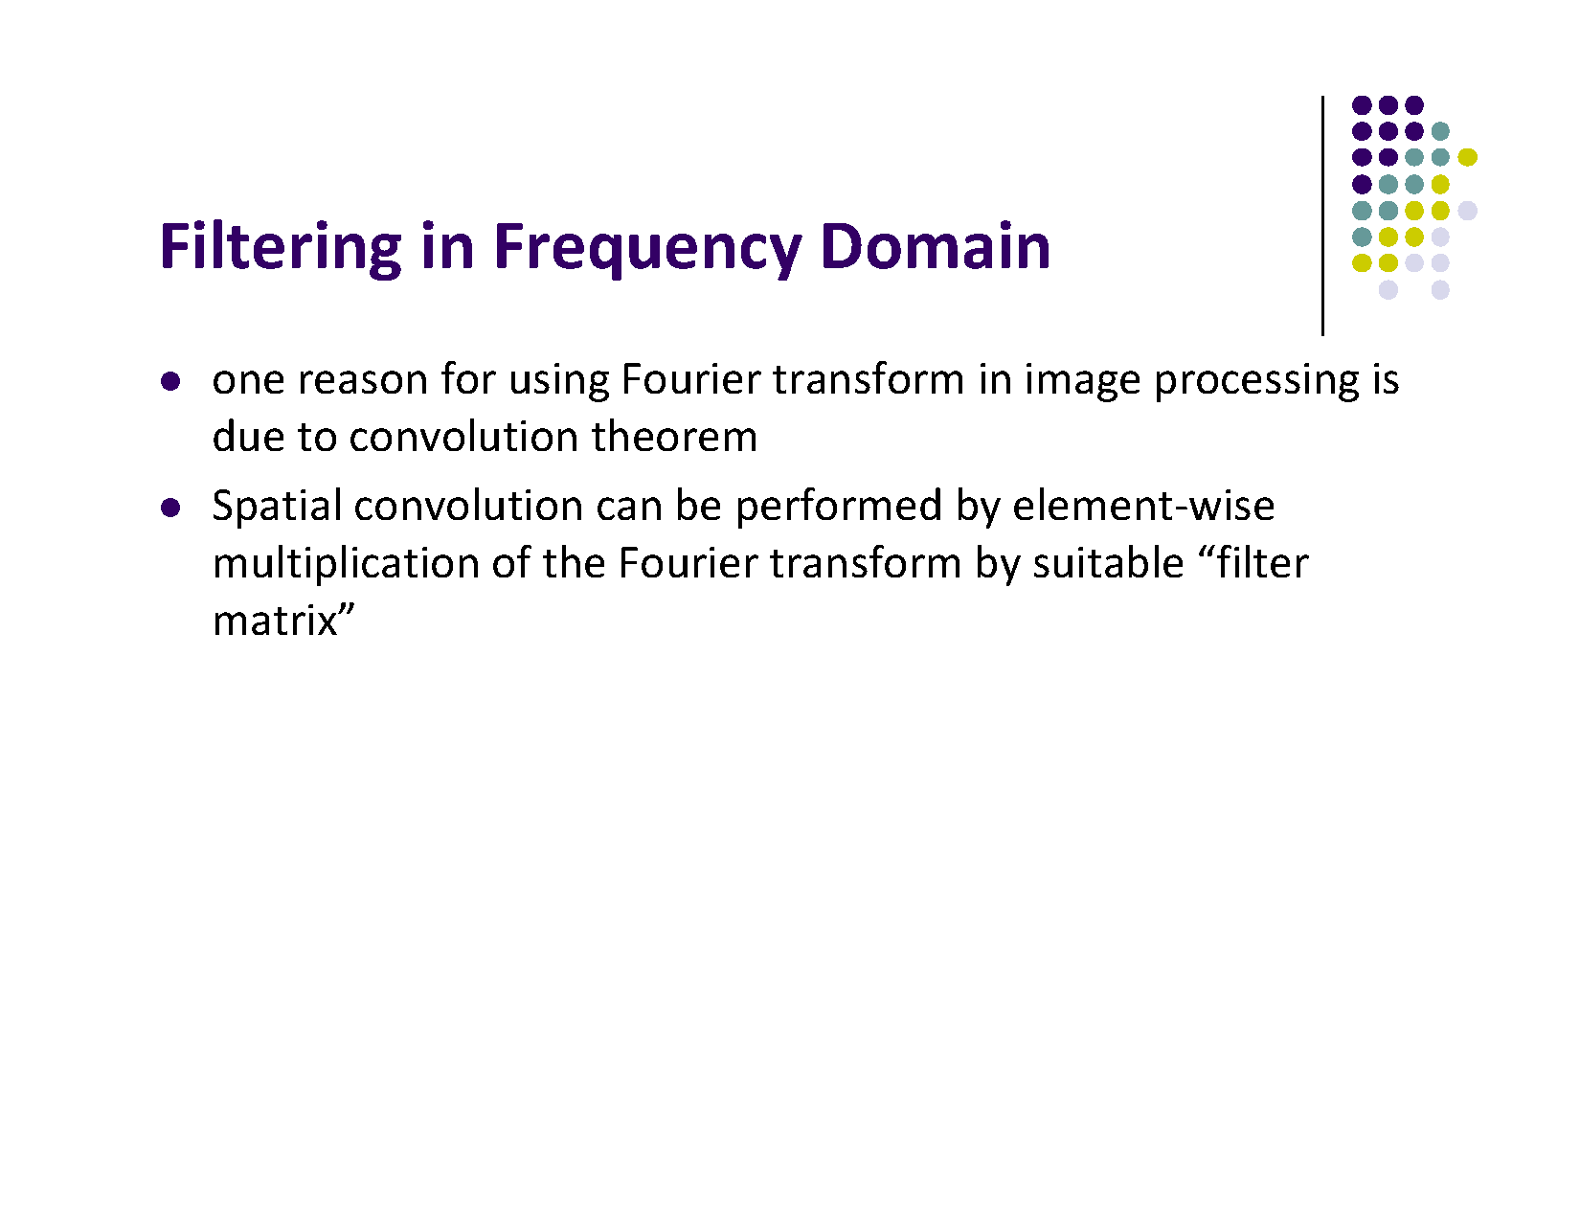

Slide 30
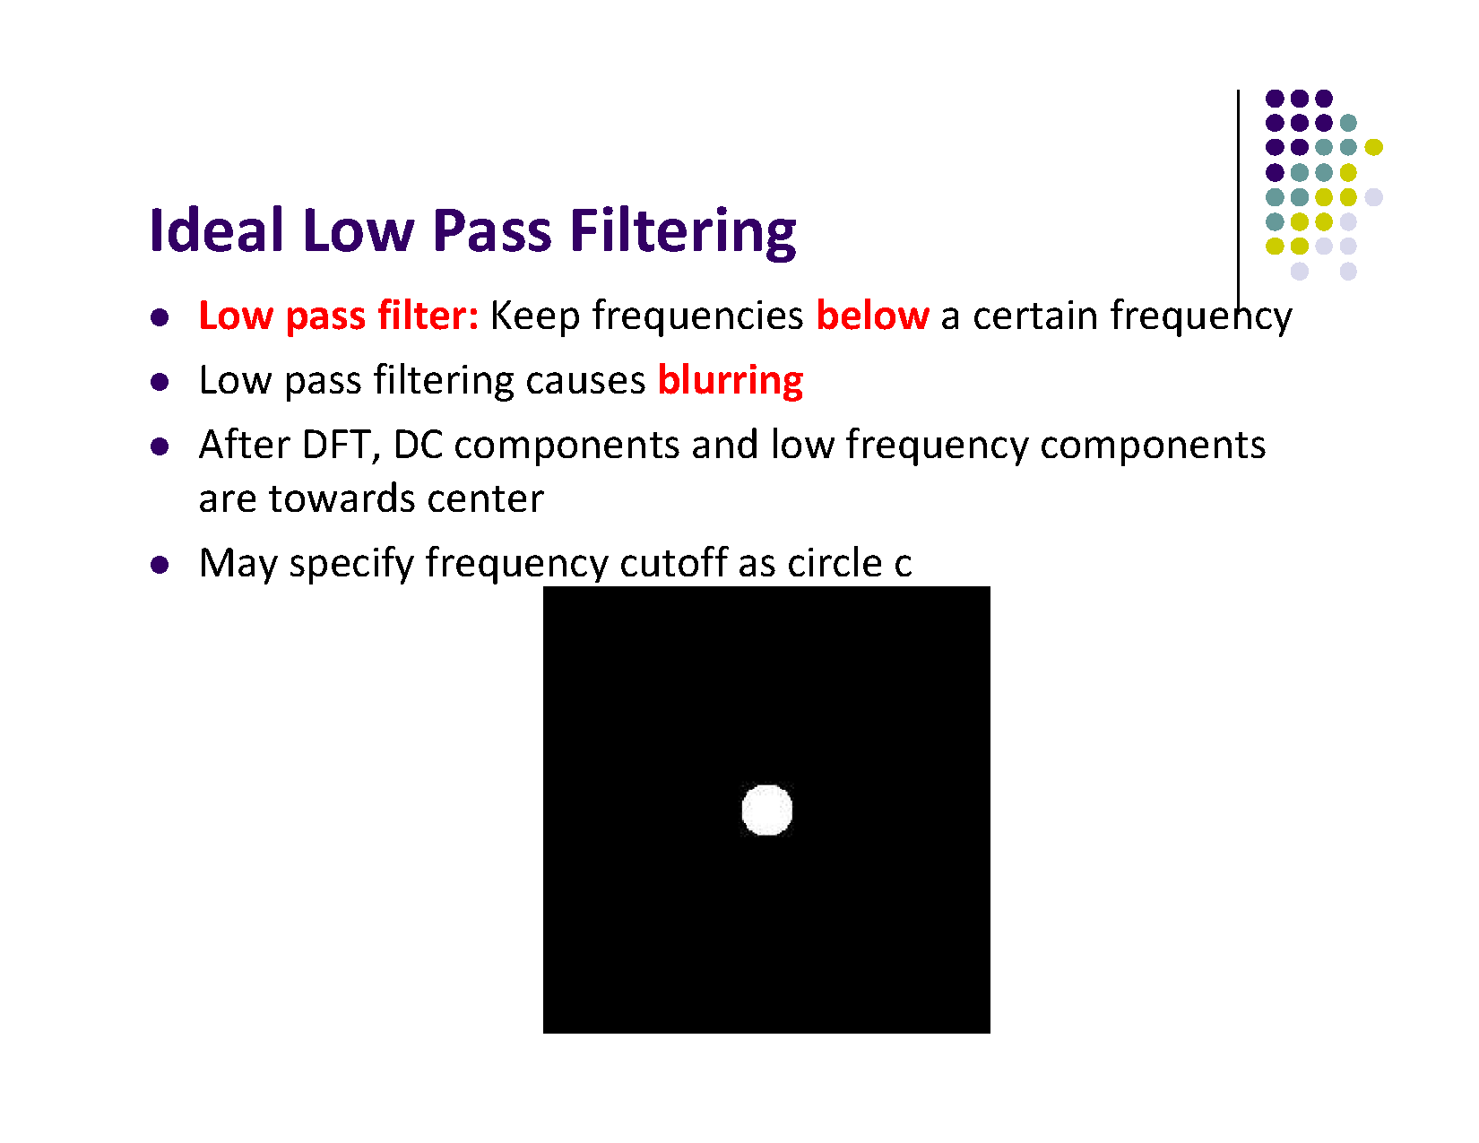

Slide 31
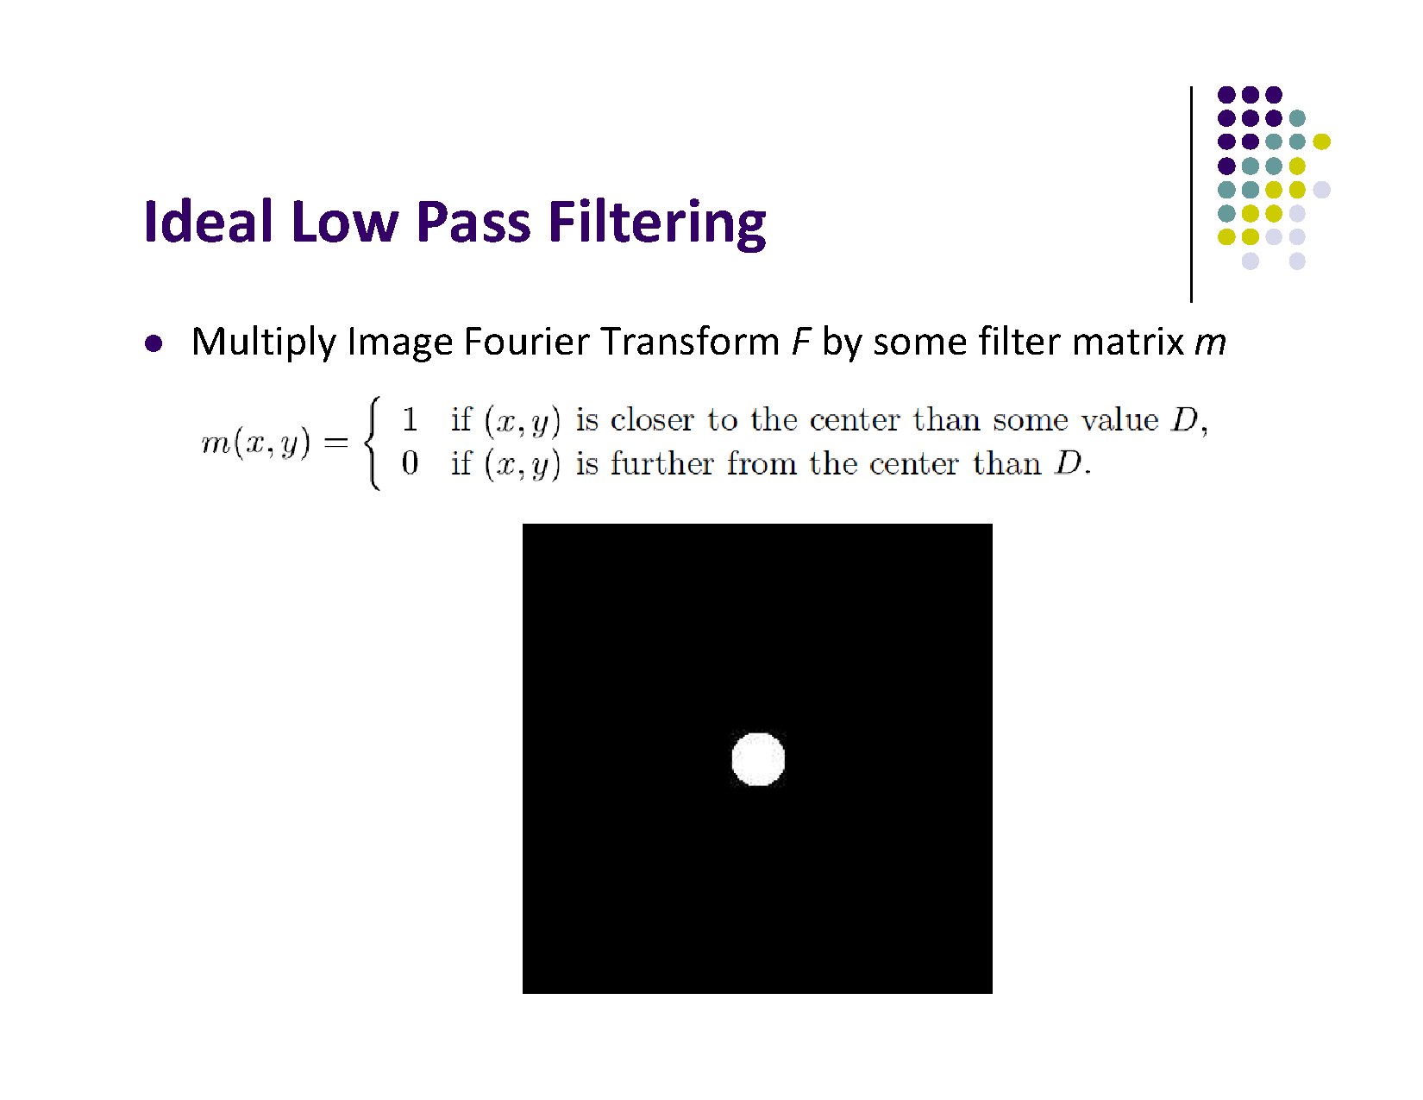

Slide 32
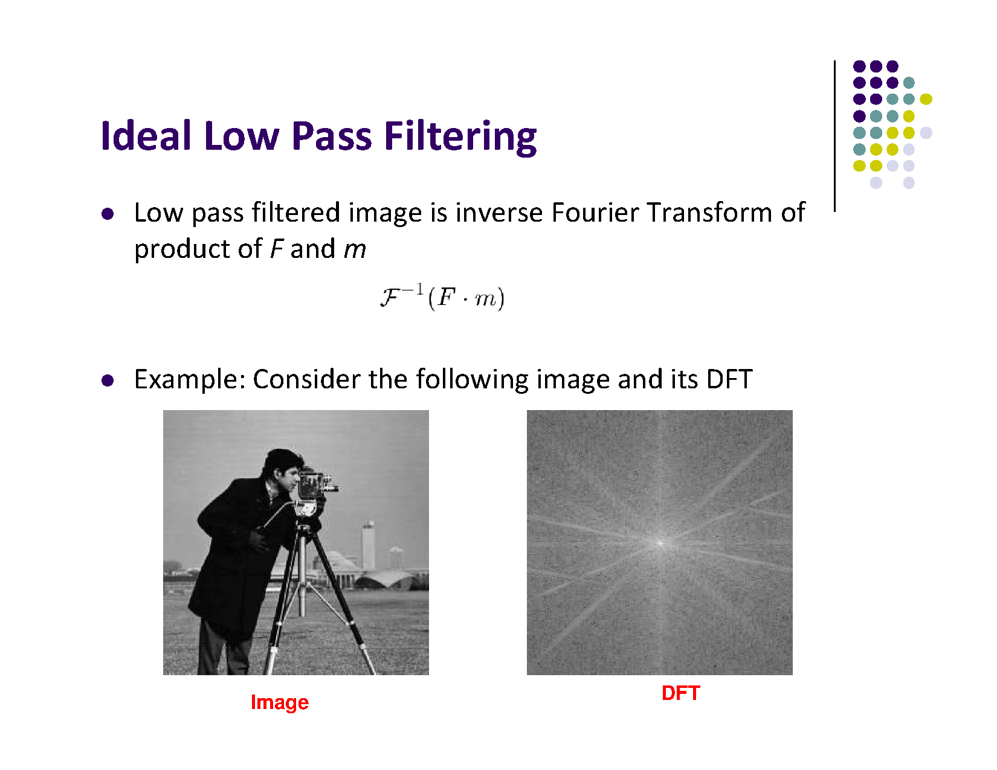

Slide 33
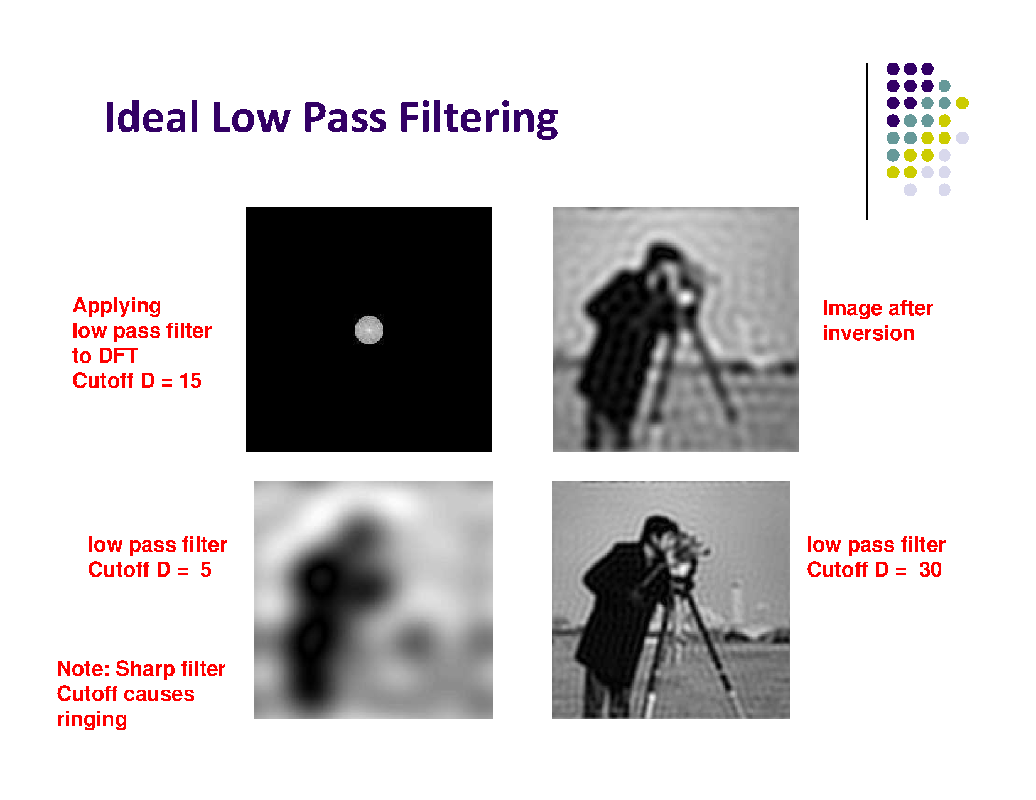

Slide 34
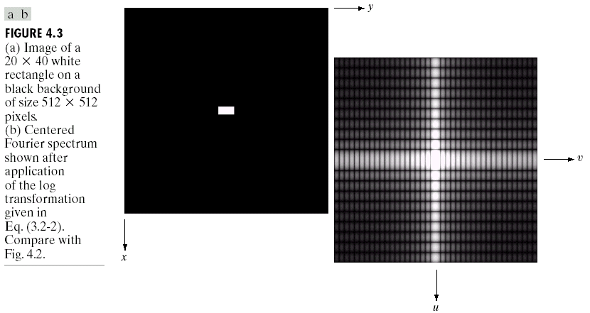
DFT & Images
The DFT of a two dimensional image can be visualised by showing the spectrum of the images component frequencies
DFT
Images taken from Gonzalez & Woods, Digital Image Processing (2002)
Notes:
34

Slide 35
DFT & Images
Images taken from Gonzalez & Woods, Digital Image Processing (2002)
Notes:
35

Slide 36
DFT & Images
Images taken from Gonzalez & Woods, Digital Image Processing (2002)
Notes:
36

Slide 37
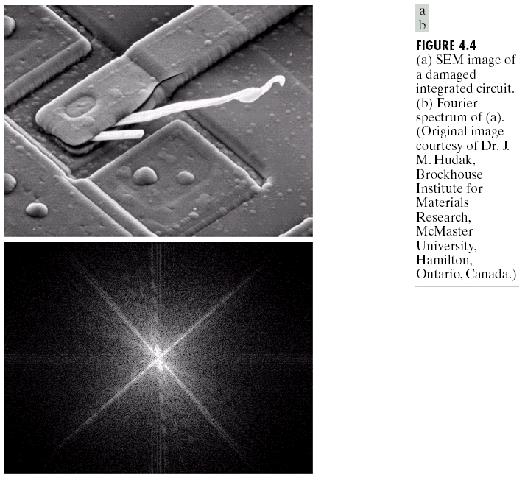
DFT & Images (cont…)
DFT
Images taken from Gonzalez & Woods, Digital Image Processing (2002)
Scanning electron microscope image of an integrated circuit magnified ~2500 times
Fourier spectrum of the image
Notes:
37

Slide 38
DFT & Images (cont…)
Images taken from Gonzalez & Woods, Digital Image Processing (2002)
Notes:
38

Slide 39
DFT & Images (cont…)
Images taken from Gonzalez & Woods, Digital Image Processing (2002)
Notes:
39

Slide 40
The Inverse DFT
It is really important to note that the Fourier transform is completely reversible
The inverse DFT is given by:
for x = 0, 1, 2…M-1 and y = 0, 1, 2…N-1
Notes:
40

Slide 41
The DFT and Image Processing
To filter an image in the frequency domain:
Multiply the input image by (-1)^{x+y} to center the transform.
Compute F(u,v) the DFT of the image
Multiply F(u,v) by a filter function H(u,v)
Compute the inverse DFT of the result in (3)
Obtain the real part of the result in (4)
Multiply the result in (5) by (-1)^{x+y}
Images taken from Gonzalez & Woods, Digital Image Processing (2002)
Notes:
41

Slide 42
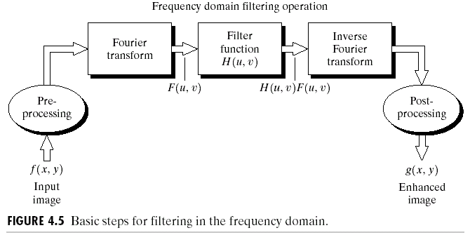
The DFT and Image Processing
Images taken from Gonzalez & Woods, Digital Image Processing (2002)
Notes:
42

Slide 43
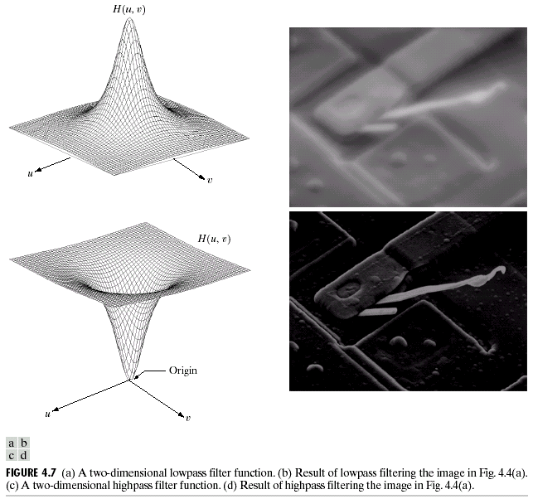
Some Basic Frequency Domain Filters
Low Pass Filter
Images taken from Gonzalez & Woods, Digital Image Processing (2002)
High Pass Filter
Notes:
43

Slide 44
Some Basic Frequency Domain Filters
Images taken from Gonzalez & Woods, Digital Image Processing (2002)
Notes:
44

Slide 45
Some Basic Frequency Domain Filters
Images taken from Gonzalez & Woods, Digital Image Processing (2002)
Notes:
45

Slide 46
Smoothing Frequency Domain Filters
Smoothing is achieved in the frequency domain by dropping out the high frequency components
The basic model for filtering is:
G(u,v) = H(u,v)F(u,v)
where F(u,v) is the Fourier transform of the image being filtered and H(u,v) is the filter transform function
Low pass filters – only pass the low frequencies, drop the high ones
Notes:
46

Slide 47
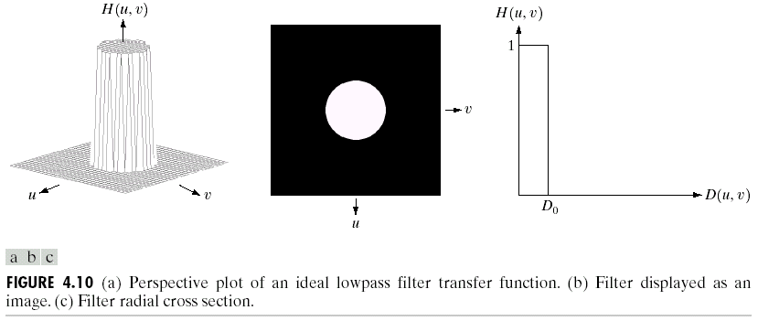
Ideal Low Pass Filter
Simply cut off all high frequency components that are a specified distance D₀ from the origin of the transform
changing the distance changes the behaviour of the filter
Images taken from Gonzalez & Woods, Digital Image Processing (2002)
Notes:
47

Slide 48
Ideal Low Pass Filter (cont…)
The transfer function for the ideal low pass filter can be given as:
where D(u,v) is given as:
Notes:
48

Slide 49
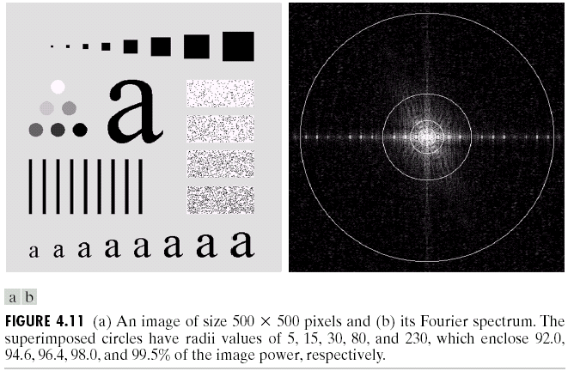
Ideal Low Pass Filter (cont…)
Images taken from Gonzalez & Woods, Digital Image Processing (2002)
Above we show an image, it’s Fourier spectrum and a series of ideal low pass filters of radius 5, 15, 30, 80 and 230 superimposed on top of it
Notes:
49

Slide 50
Ideal Low Pass Filter (cont…)
Images taken from Gonzalez & Woods, Digital Image Processing (2002)
Notes:
50

Slide 51
Ideal Low Pass Filter (cont…)
Images taken from Gonzalez & Woods, Digital Image Processing (2002)
Notes:
51

Slide 52
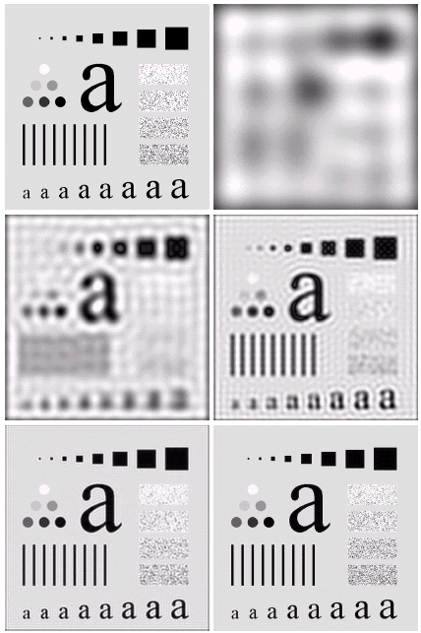
Ideal Low Pass Filter (cont…)
Result of filtering with ideal low pass filter of radius 5
Original image
Result of filtering with ideal low pass filter of radius 15
Result of filtering with ideal low pass filter of radius 30
Images taken from Gonzalez & Woods, Digital Image Processing (2002)
Result of filtering with ideal low pass filter of radius 80
Result of filtering with ideal low pass filter of radius 230
Notes:
52

Slide 53
Ideal Low Pass Filter (cont…)
Result of filtering with ideal low pass filter of radius 5
Images taken from Gonzalez & Woods, Digital Image Processing (2002)
Notes:
53

Slide 54
Ideal Low Pass Filter (cont…)
Result of filtering with ideal low pass filter of radius 15
Images taken from Gonzalez & Woods, Digital Image Processing (2002)
Notes:
54

Slide 55
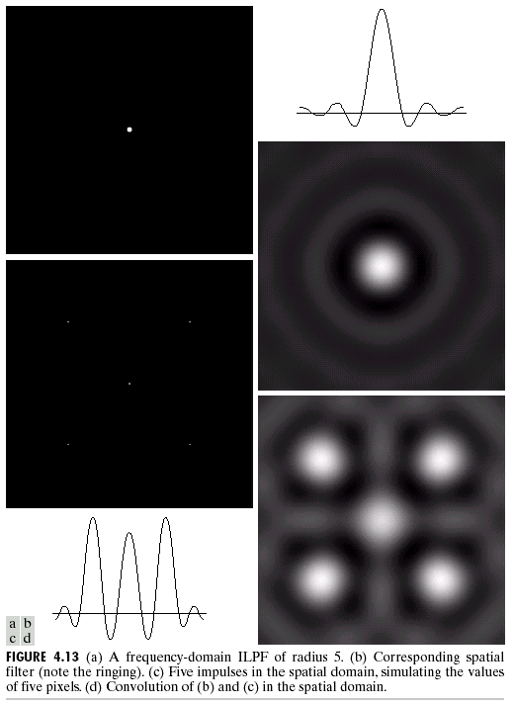
Image Enhancement in the
Frequency Domain

Slide 56
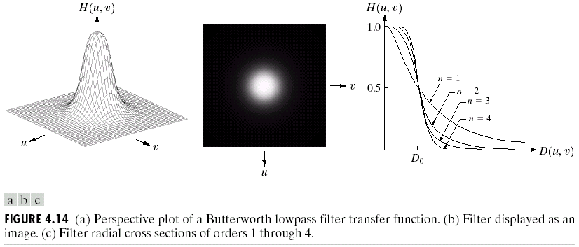
Butterworth Lowpass Filters
The transfer function of a Butterworth lowpass filter of order n with cutoff frequency at distance D₀ from the origin is defined as:
Images taken from Gonzalez & Woods, Digital Image Processing (2002)
Notes:
56

Slide 57
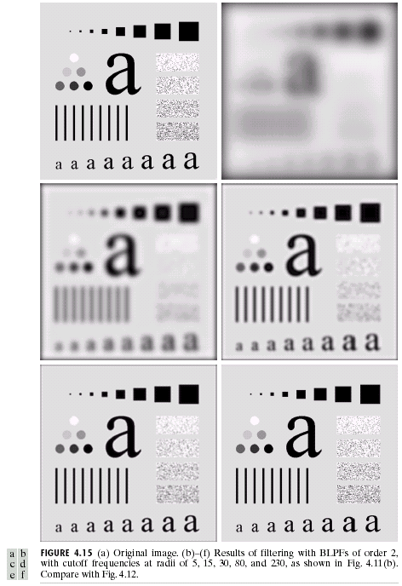
Butterworth Lowpass Filter (cont…)
Result of filtering with Butterworth filter of order 2 and cutoff radius 5
Original image
Result of filtering with Butterworth filter of order 2 and cutoff radius 15
Result of filtering with Butterworth filter of order 2 and cutoff radius 30
Images taken from Gonzalez & Woods, Digital Image Processing (2002)
Result of filtering with Butterworth filter of order 2 and cutoff radius 80
Result of filtering with Butterworth filter of order 2 and cutoff radius 230
Notes:
57

Slide 58
Butterworth Lowpass Filter (cont…)
Original image
Result of filtering with Butterworth filter of order 2 and cutoff radius 5
Images taken from Gonzalez & Woods, Digital Image Processing (2002)
Notes:
58

Slide 59
Butterworth Lowpass Filter (cont…)
Result of filtering with Butterworth filter of order 2 and cutoff radius 15
Images taken from Gonzalez & Woods, Digital Image Processing (2002)
Notes:
59

Slide 60
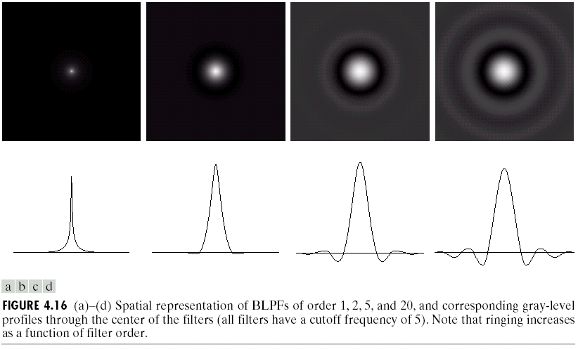
Image Enhancement in the
Frequency Domain

Slide 61
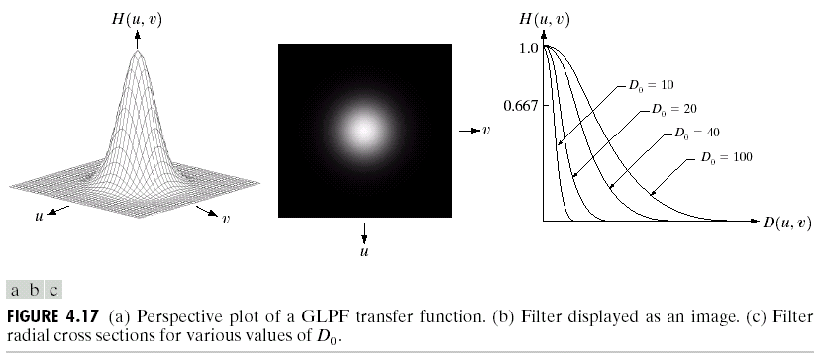
Gaussian Lowpass Filters
The transfer function of a Gaussian lowpass filter is defined as:
Images taken from Gonzalez & Woods, Digital Image Processing (2002)
Notes:
61

Slide 62
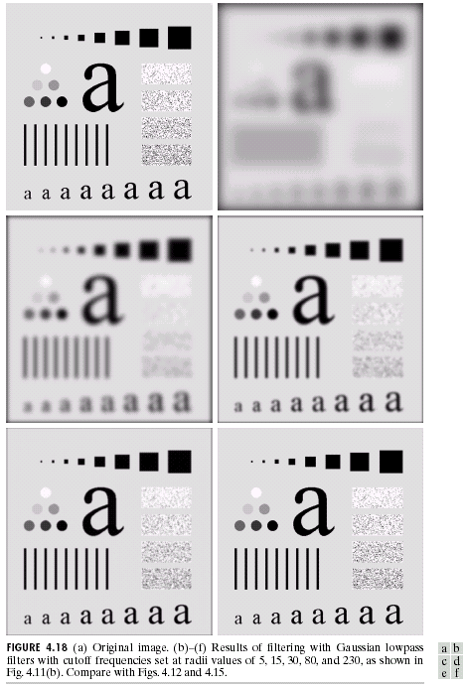
Gaussian Lowpass Filters (cont…)
Result of filtering with Gaussian filter with cutoff radius 5
Original image
Result of filtering with Gaussian filter with cutoff radius 15
Result of filtering with Gaussian filter with cutoff radius 30
Images taken from Gonzalez & Woods, Digital Image Processing (2002)
Result of filtering with Gaussian filter with cutoff radius 85
Result of filtering with Gaussian filter with cutoff radius 230
Notes:
62

Slide 63
Lowpass Filters Compared
Result of filtering with ideal low pass filter of radius 15
Result of filtering with Butterworth filter of order 2 and cutoff radius 15
Images taken from Gonzalez & Woods, Digital Image Processing (2002)
Result of filtering with Gaussian filter with cutoff radius 15
Notes:
63

Slide 64
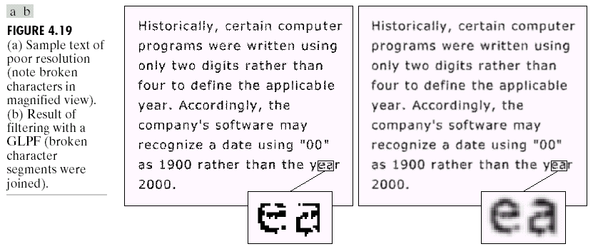
Lowpass Filtering Examples
A low pass Gaussian filter is used to connect broken text
Images taken from Gonzalez & Woods, Digital Image Processing (2002)
Notes:
64

Slide 65
Lowpass Filtering Examples
Images taken from Gonzalez & Woods, Digital Image Processing (2002)
Notes:
65

Slide 66
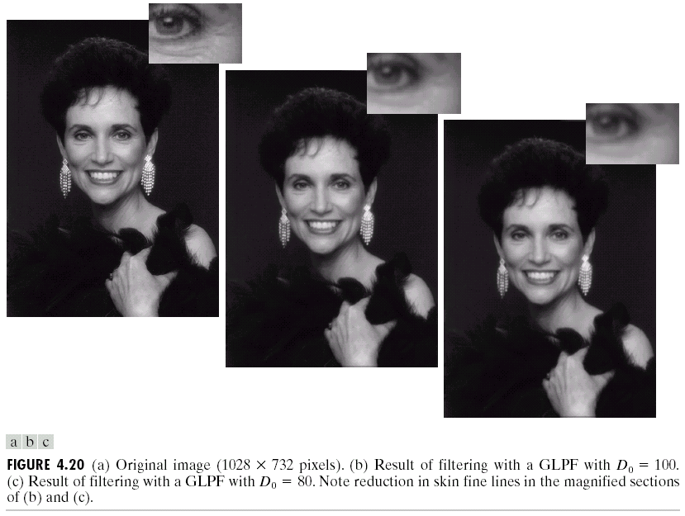
Lowpass Filtering Examples (cont…)
Different lowpass Gaussian filters used to remove blemishes in a photograph
Images taken from Gonzalez & Woods, Digital Image Processing (2002)
Notes:
66

Slide 67
Sharpening in the Frequency Domain
Edges and fine detail in images are associated with high frequency components
High pass filters – only pass the high frequencies, drop the low ones
High pass frequencies are precisely the reverse of low pass filters, so:
H_{hp}(u, v) = 1 – H_{lp}(u, v)
Notes:
67

Slide 68
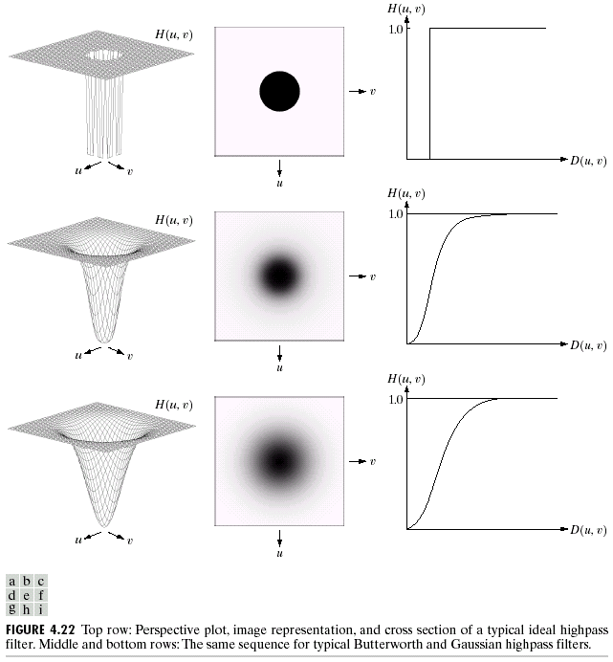
Ideal High Pass Filters
The ideal high pass filter is given as:
where D₀ is the cut off distance as before
Images taken from Gonzalez & Woods, Digital Image Processing (2002)
Notes:
68

Slide 69
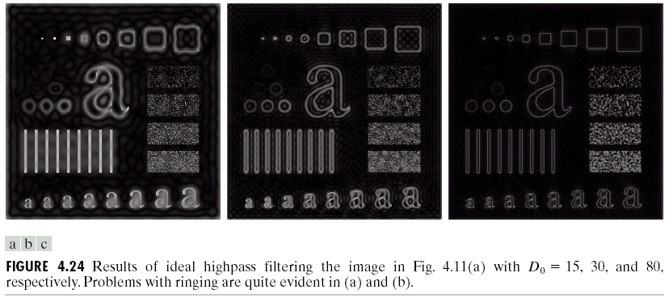
Ideal High Pass Filters (cont…)
Images taken from Gonzalez & Woods, Digital Image Processing (2002)
Results of ideal high pass filtering with D₀ = 15
Results of ideal high pass filtering with D₀ = 30
Results of ideal high pass filtering with D₀ = 80
Notes:
69

Slide 70
Butterworth High Pass Filters
The Butterworth high pass filter is given as:
where n is the order and D₀ is the cut off distance as before
Images taken from Gonzalez & Woods, Digital Image Processing (2002)
Notes:
70

Slide 71
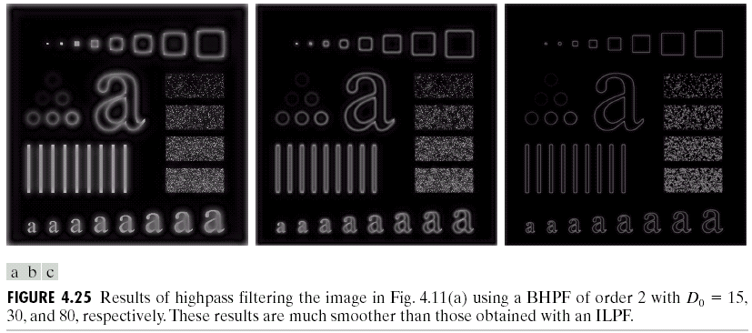
Butterworth High Pass Filters (cont…)
Results of Butterworth high pass filtering of order 2 with D₀ = 15
Images taken from Gonzalez & Woods, Digital Image Processing (2002)
Results of Butterworth high pass filtering of order 2 with D₀ = 80
Results of Butterworth high pass filtering of order 2 with D₀ = 30
Notes:
71

Slide 72
Gaussian High Pass Filters
The Gaussian high pass filter is given as:
where D₀ is the cut off distance as before
Images taken from Gonzalez & Woods, Digital Image Processing (2002)
Notes:
72

Slide 73
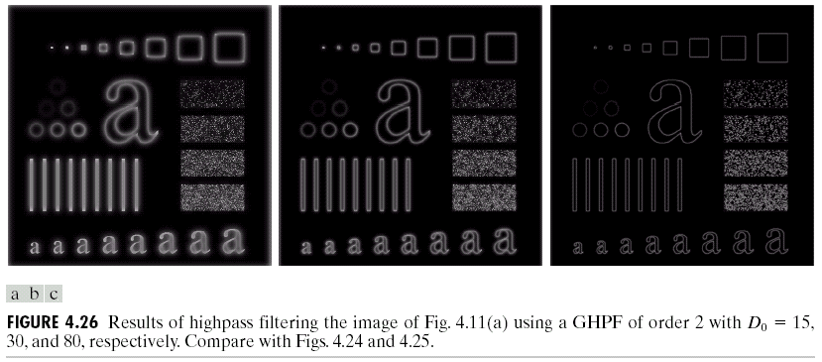
Gaussian High Pass Filters (cont…)
Images taken from Gonzalez & Woods, Digital Image Processing (2002)
Results of Gaussian high pass filtering with D₀ = 80
Results of Gaussian high pass filtering with D₀ = 15
Results of Gaussian high pass filtering with D₀ = 30
Notes:
73

Slide 74
Highpass Filter Comparison
Results of ideal high pass filtering with D₀ = 15
Images taken from Gonzalez & Woods, Digital Image Processing (2002)
Notes:
74

Slide 75
Highpass Filter Comparison
Results of Butterworth high pass filtering of order 2 with D₀ = 15
Images taken from Gonzalez & Woods, Digital Image Processing (2002)
Notes:
75

Slide 76
Highpass Filter Comparison
Results of Gaussian high pass filtering with D₀ = 15
Images taken from Gonzalez & Woods, Digital Image Processing (2002)
Notes:
76

Slide 77
Highpass Filter Comparison
Images taken from Gonzalez & Woods, Digital Image Processing (2002)
Results of ideal high pass filtering with D₀ = 15
Results of Butterworth high pass filtering of order 2 with D₀ = 15
Results of Gaussian high pass filtering with D₀ = 15
Notes:
77

Slide 78
Highpass Filter Comparison
Results of ideal high pass filtering with D₀ = 15
Images taken from Gonzalez & Woods, Digital Image Processing (2002)
Notes:
78

Slide 79
Highpass Filter Comparison
Results of Butterworth high pass filtering of order 2 with D₀ = 15
Images taken from Gonzalez & Woods, Digital Image Processing (2002)
Notes:
79

Slide 80
Highpass Filter Comparison
Results of Gaussian high pass filtering with D₀ = 15
Images taken from Gonzalez & Woods, Digital Image Processing (2002)
Notes:
80

Slide 81
Image Enhancement in the
Frequency Domain

Slide 82
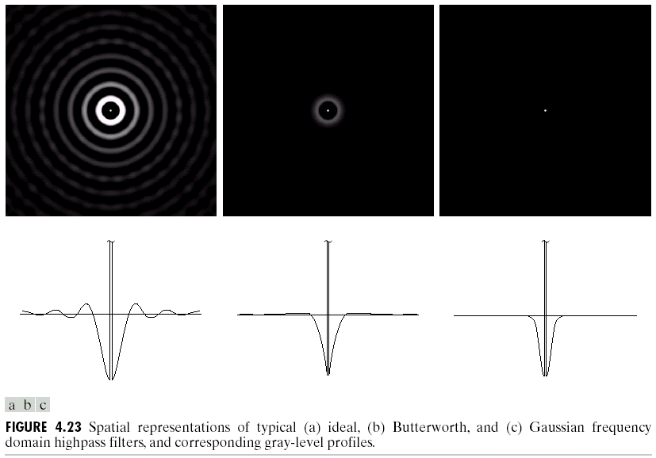
Image Enhancement in the
Frequency Domain

Slide 83
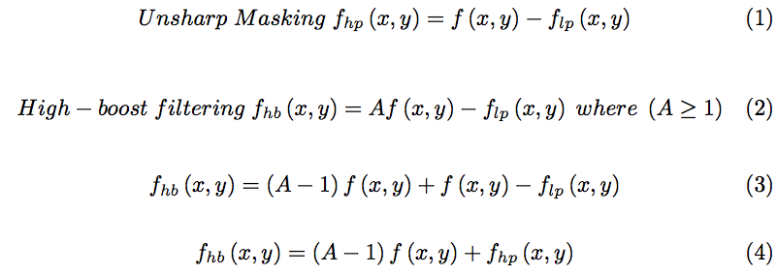
Highpass Filter Comparison
Images taken from Gonzalez & Woods, Digital Image Processing (2002)
Notes:
83

Slide 84
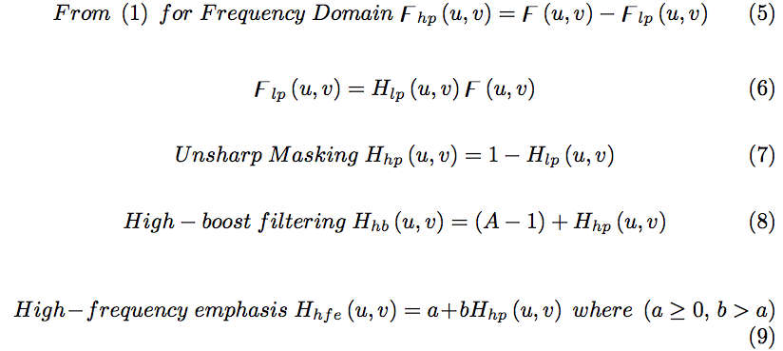
Highpass Filter Comparison
Images taken from Gonzalez & Woods, Digital Image Processing (2002)
Notes:
84

Slide 85
Highpass Filter Comparison
The process consists of multiplying the composite filter by the (centered) transform of the input image and then taking the inverse transform of the product. Multiplication of the real part of this result by (-1)^{x+y} gives us the high-boost filtered image f_{hb}(x,y) in the spatial domain.
Images taken from Gonzalez & Woods, Digital Image Processing (2002)
Notes:
85

Slide 86
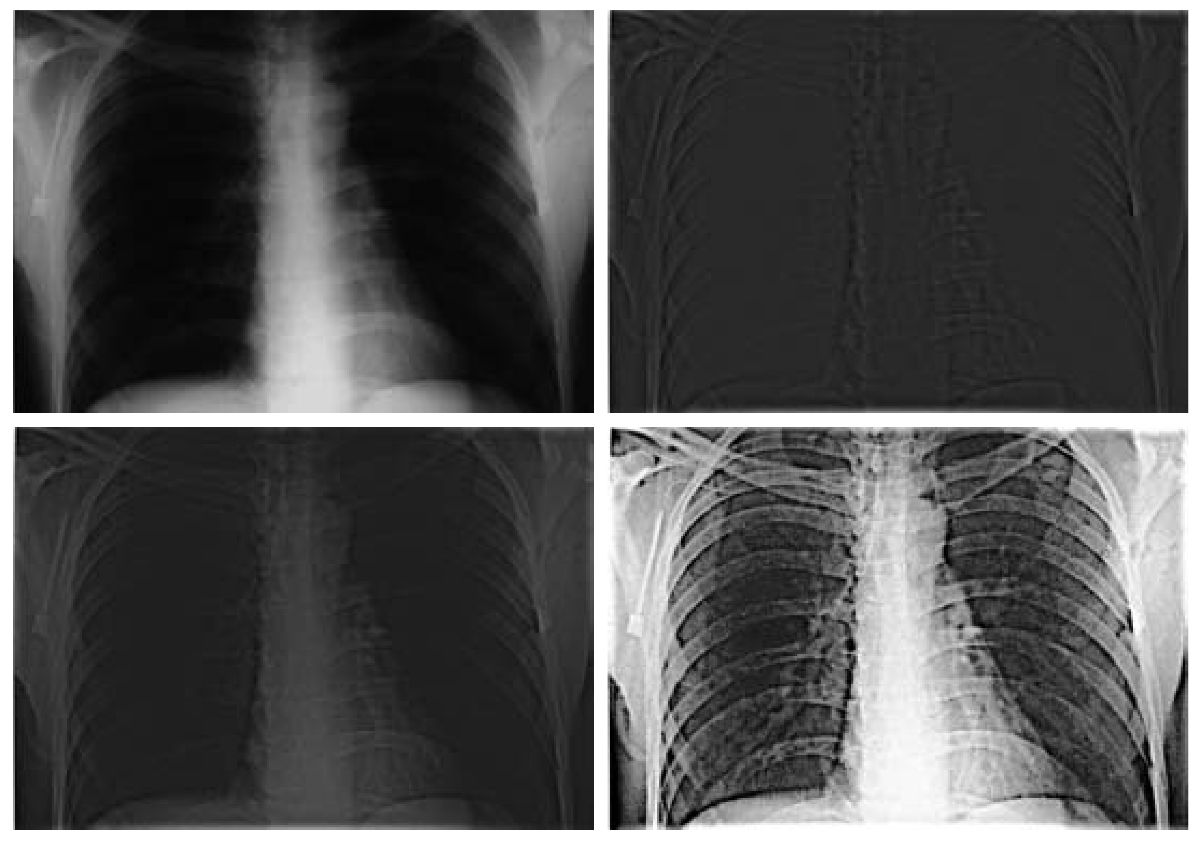
Highpass Filtering Example
Original image
Highpass filtering result
Images taken from Gonzalez & Woods, Digital Image Processing (2002)
High frequency emphasis result
After histogram equalisation
Notes:
86

Slide 87
Highpass Filtering Example
Notes:
87

Slide 88
Highpass Filtering Example
Notes:
88

Slide 89
Highpass Filtering Example
Notes:
89

Slide 90
Highpass Filtering Example
Notes:
90

Slide 91

Laplacian In The Frequency Domain
Images taken from Gonzalez & Woods, Digital Image Processing (2002)
Notes:
91

Slide 92

Laplacian In The Frequency Domain
Images taken from Gonzalez & Woods, Digital Image Processing (2002)
Equation (1) gives the laplacian result whereas equation (2) and (3) gives the enhanced image after taking the laplacian.
Notes:
92

Slide 93

Laplacian In The Frequency Domain
2-D image of Laplacian in the frequency domain
Laplacian in the frequency domain
Images taken from Gonzalez & Woods, Digital Image Processing (2002)
Inverse DFT of Laplacian in the frequency domain
Zoomed section of the image on the left compared to spatial filter
Notes:
93

Slide 94

Frequency Domain Laplacian Example
Original image
Laplacian filtered image
Laplacian image scaled
Enhanced image
Notes:
94

Slide 95
Fast Fourier Transform
The reason that Fourier based techniques have become so popular is the development of the Fast Fourier Transform (FFT) algorithm
Allows the Fourier transform to be carried out in a reasonable amount of time
Reduces the amount of time required to perform a Fourier transform by a factor of 100 – 600 times!
Notes:
95

Slide 96
Frequency Domain Filtering & Spatial Domain Filtering
Similar jobs can be done in the spatial and frequency domains
Filtering in the spatial domain can be easier to understand
Filtering in the frequency domain can be much faster – especially for large images
Notes:
96

